Slide 1
The Bible and Its Influence:
“The Wilderness and the Law”
Liz Lopez and Micaela Veglia

Slide 2
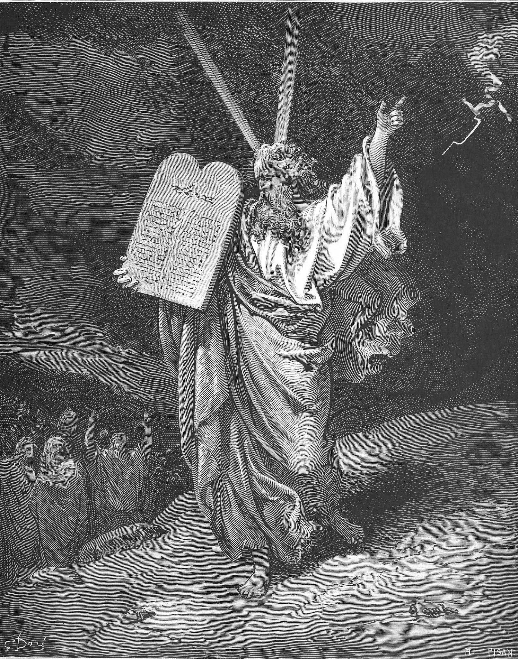
Moses
He is the author of the Torah (Jewish term for the 1st 5 books)
  Genesis, Exodus, Leviticus, Numbers, and Deuteronomy
This books contain the origins and growth as people that contain the laws given on Mount Sinai (also known as Mosaic Law)

Slide 3
Books of Exodus
Israelites had many reasons to celebrate.
They got freedom from slavery in Egypt. They had God’s promise of a land flowing with milk and honey.
With 3 days in the wilderness they counter bitter waters in Mara and where very thirsty. In Exodus God told Meses, to put a tree in the water to make it sweet.
A pattern repeats during the wanderings that Israelites complain and rebel and Moses intercedes with God and God helps. God comes with new Rules
This Rules are a must to obey in order to keep faith

Slide 4
Moses the Lawgiver
Moses is a heroic liberator to political leader, wise judge, lawgiver and prophet with the privilege to talk to God
God’s covenant with Abraham included a promise to make a great nation out of his descendants
  But a covenant as the organized law of society is as scholar Michael Walzer put is “the political invention of the book of Exodus.”
In Exodus 19 God makes an other covenant with the Israelites
  God tells them that they have seen what he has done to the Egyptians and he has brought them to himself.
  If they obeys and keeps his covenant, and they will be his treasure procession out of all people.
  God wants them to be for him a priestly kingdom and a holy nation

Slide 5
The Ten Commandments
I am the Lord thy God, which have brought thee out of the land of Egypt, out of the house of bondage.
Thou shalt have not other gods before me.
Thou shalt not make unto thee any graven image, or any likeness of any thing that is in heaven above, or that is is the earth beneath, or that is in the water under the earth.
Thou shalt not take the name of the Lord thy God in vain.
Remember the Sabbath day, to keep it holy. Six days shalt thou labour, and do thy work: But the seventh day is the sabbath of the Lord thy God: in it thou shalt not do any work.

Slide 6
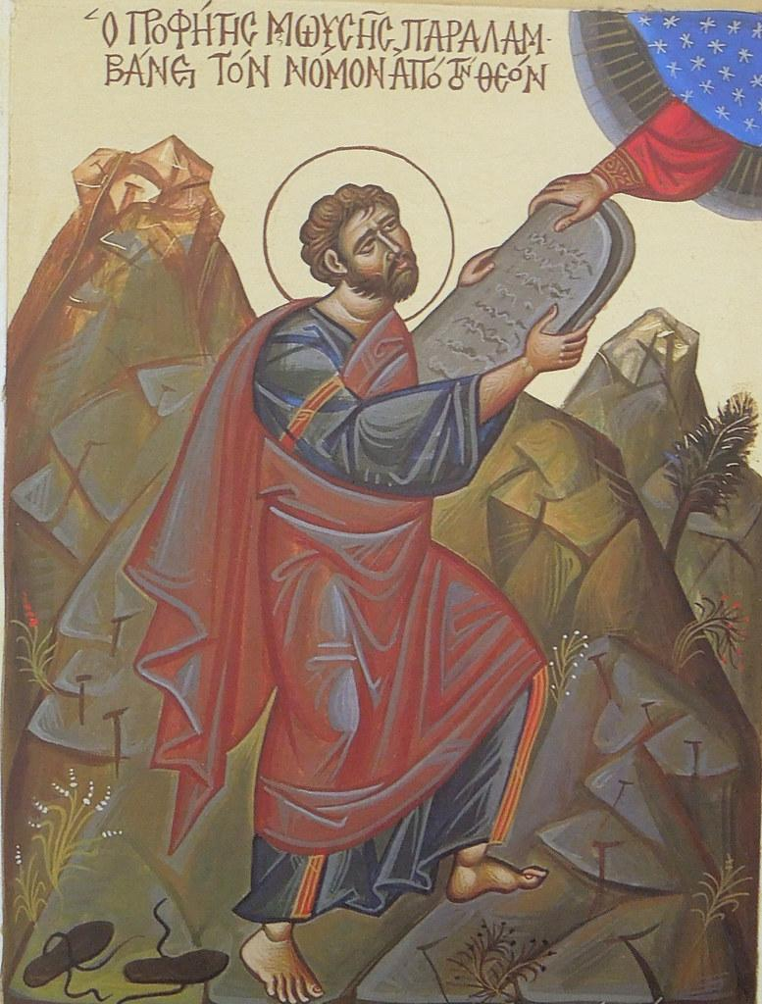
5. Honor your Father and thy Mother
6. Thou shalt not kill
7. Thou shalt not commit adultery.
8. Thou shalt not steal
9. Thou shalt not bear false witness against thy neighbour.
10. Thou shalt not covet thy neighbor’s house, thou shalt not covet thy neighbor’s wife, nor his manservant, nor his maidservant, nor his ox, nor his ass, nor any thing is thy neighbor’s.

Slide 7
Laws for Living
The Ten Commandments
  Universal laws with no degrees of seriousness or mitigated excuses
  In Christianity, Jesus endorses them as natural law, or basic moral truths
Exodus-Deuteronomy provide principles and practices for Judaism
In Jewish tradition, there are 613 commandments (mitzvot) that cover all aspects of human life
  Personal injury, murder, and warfare
  Ritual and dietary laws
  Property, household management
  Obligations toward vulnerable members of society
  Protection to slaves

Slide 8
Examples of Laws
Jubilee Year
  Every 50 years, slaves must be offered freedom
Animal Sacrifice
  Many ancient cultures had sacrificial traditions
  Purpose of sacrifice was to “draw near” (korban) to God
  God deserved the best: first fruits, best of a herd/flock
  Burnt offerings
Keeping Kosher
  “Ritually acceptable”
  Dietary laws to stay nearer to holiness and God
  Ex: Keeping meat and dairy separate

Slide 9
Justice
Many laws in place to protect the poor and weak
  Property owners forbidden to reap all food from their lands
  Justice must be delivered impartially
  Not to punish children for the sins of their parents
  Only the individual who commits the crime can be punished by law
  “Eye for an eye, tooth for a tooth” in Exodus 21.24. Limits retribution and prevents disproportionate punishment
Deuteronomy: Moses reminds the Israelites that hope lies in faithfulness to God

Slide 10
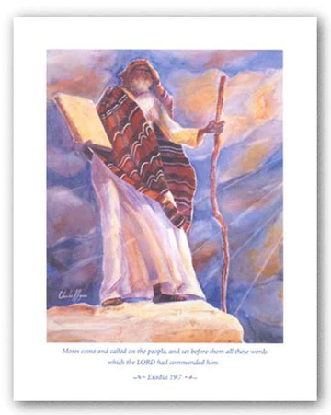
Influence
Jubilee Year
  Christians in the Middle Ages made a pilgrimage to Rome every 50 years
  “Come the jubilee” became a rallying cry for slaves in the American South
  Leviticus 25.10 on the Liberty Bell
The Opera, Moses und Aron by Arnold Schoenberg
The American civil rights movement

