Slide 1
Chapter 28: The Birth of the Church
The Bible and It's Influence
Tara Baisley-Gomes

Slide 2
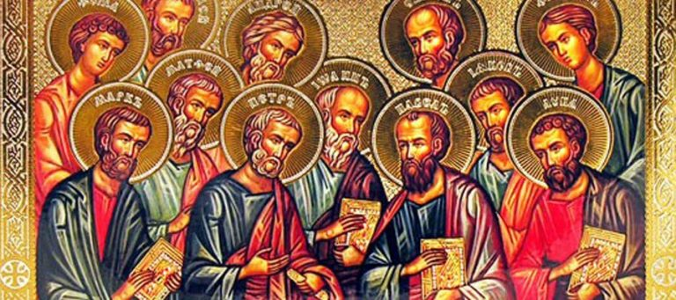
Introduction
The Acts of the Apostles is a unique continuation from the Gospel of Luke, both addressed to Theophilus.
It closely resembles the gospels in literary form, continuing the narrative style and themes established in Luke's Gospel.
https://stpaulcenter.com/how-to-read-the-acts-of-the-apostles/

Slide 3
Journey Theme
Acts traces a significant journey from Jerusalem to Rome, documenting travels through 32 countries, 54 cities, and 9 Mediterranean islands.
This journey serves as a narrative thread, showing the expansion of the early church along Greek shipping routes and into diverse cultural contexts.

Slide 4
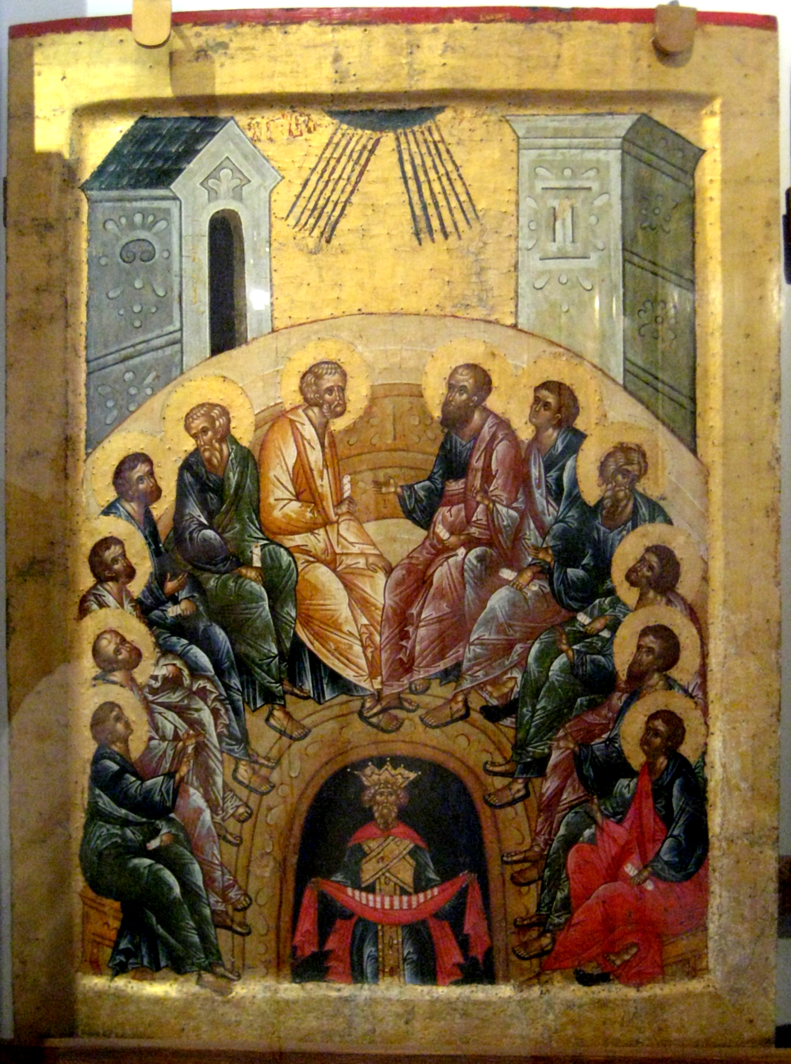
Pentecost
Pentecost, a pivotal event in Acts, marks the descent of the Holy Spirit upon the apostles.
It is portrayed as a reversal of the Tower of Babel story, highlighting unity through diverse languages and the empowerment of the early church for its mission.
This Photo by Unknown author is licensed under CC BY-SA.

Slide 5
Healing and Preaching
Acts vividly portrays apostolic healing, echoing the miraculous deeds of Jesus documented in Luke's Gospel.
These healings serve as a powerful demonstration of continuity between Jesus' ministry and the ongoing mission of the early church, emphasizing divine authority and compassion.

Slide 6
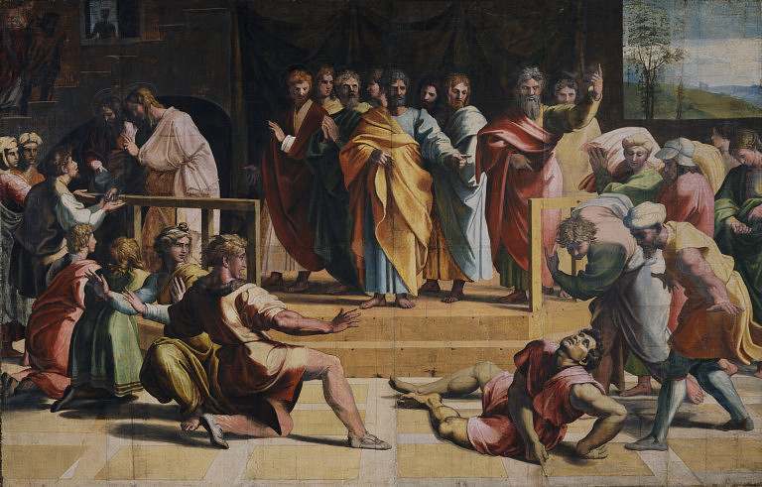
Common Life
The early Christian community embraced a culture of sharing possessions, reflecting ideals of communal living and mutual support.
However, the cautionary tale of Ananias and Sapphira underscores the importance of honesty and integrity within the community, warning against deceit and hypocrisy.
https://en.wikipedia.org/wiki/Ananias_and_Sapphira

Slide 7
Imprisonment
Despite facing persecution, the apostles remained steadfast in their mission to preach the gospel.
Gamaliel's wise counsel and the council's release with a warning underscore the resilience of the apostles, who rejoiced in their suffering for the sake of Christ.

Slide 8
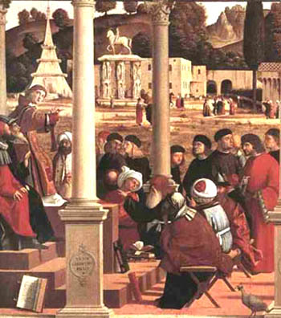
Appointment of Deacons
Conflict between Hellenists and Hebrews within the early Christian community necessitated the appointment of deacons.
Among them was Stephen, who emerged as a pivotal figure, serving the community and actively engaging in preaching the gospel message.
https://vridar.org/2011/12/12/stephen-the-hellenistic-hebrew-division-in-the-jerusalem-church-2/

Slide 9
Stephen's Speech and Martyrdom
Stephen delivered a powerful speech, confronting Jewish authorities and highlighting their history of resistance to God's messengers.
His martyrdom marked a significant turning point, illustrating early tensions between Jewish authorities and the burgeoning Christian community, emphasizing the cost of proclaiming the gospel message.

