Slide 1
The Evolution of Divine Covenants in Genesis and Exodus
Tara Baisley-Gomes

Slide 2
01.
Introduction to Divine Covenants

Slide 3
Covenants represent solemn agreements between God and His people, often accompanied by specific promises and obligations.
  These are not merely contracts but sacred bonds that carry deep spiritual significance.
Covenants are foundational to understanding the narrative of the Bible, serving as key moments where God reveals His intentions, promises, and expectations to humanity
They establish the framework within which God's relationship with His people evolves, marking periods of commitment, faithfulness, and sometimes, renewal after disobedience.

Slide 4
Genesis introduces the concept of covenants with the Noahic and Abrahamic Covenants, emphasizing themes of divine promise, human obligation, and the beginnings of a chosen lineage.
Exodus builds upon this foundation with the Mosaic Covenant, transitioning to a communal agreement centered around the Law, which defines the Israelites' national identity and collective moral compass.
Thesis Statement: The evolution of divine covenants from Genesis to Exodus reflects a deliberate shift from personal faith to communal responsibility, marking a foundational transformation in the Israelite identity and their covenantal relationship with God.

Slide 5
02.
Covenants in Genesis

Slide 6
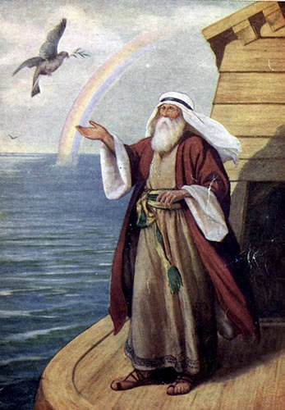
Noahic Covenant
Universal Promise: God's commitment to never again destroy all life with a flood, signifying universal care and mercy.
Symbol of Hope: The rainbow as a visible sign of this everlasting covenant, representing hope and a fresh start for all creation.
This Photo by Unknown author is licensed under CC BY-NC-ND.

Slide 7
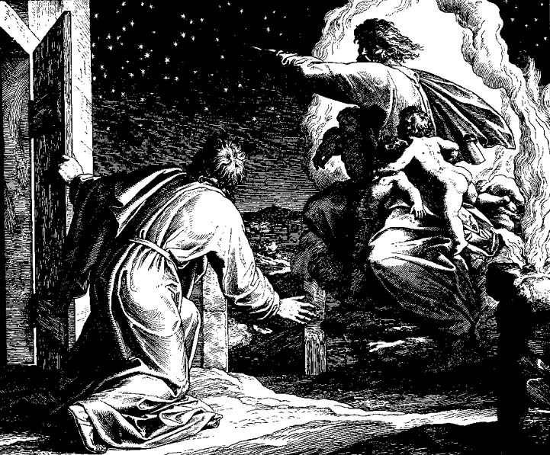
Abrahamic Covenant
Foundational Promises: God's pledge to Abraham of countless descendants and the land of Canaan, setting the groundwork for Israel's future.
Sign of Faith: Circumcision introduced as a physical and spiritual mark of the covenant, symbolizing obedience and dedication to God.
https://www.jesuswalk.com/abraham/4_covenant.htm

Slide 8
03.
Covenants in Exodus

Slide 9
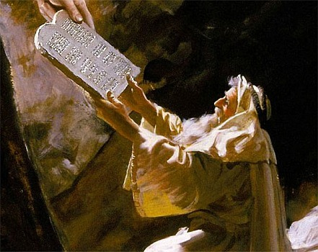
Covenant at Mount Sinai
Divine Assembly: Establishment of the covenant amidst dramatic natural phenomena, symbolizing God's power and presence.
National Covenant: Shift from individual to national covenant, underlining Israel's collective identity and responsibility.
The Ten Commandments
Moral Foundation: Serve as the cornerstone of moral and ethical conduct for the Israelites, guiding their relationship with God and each other.
Divine Law: The commandments as direct divine instructions, forming the core of the Israelite legal and ethical system.
This Photo by Unknown author is licensed under CC BY-NC-ND.

Slide 10
04.
Comparative Analysis

Slide 11
From Genesis to Exodus: A Shift in Focus
Themes and Promises
Genesis: Underscores individual covenants with Noah and Abraham, highlighting personal faith and direct promises from God.
Exodus: Introduces the Mosaic Covenant, centering on a communal agreement with the Israelites, underlined by collective responsibility and obedience.
Genesis: Themes of universal care (Noahic Covenant) and foundational promises (Abrahamic Covenant), with symbols like the rainbow and circumcision representing God's promises and human response.
Exodus: The Mosaic Covenant introduces a structured, communal framework with the Ten Commandments as core ethical and moral guidelines for the entire community.

Slide 12
Relationship Dynamics
Evolution of Divine Expectations
Personal vs. Communal: Genesis covenants cultivate a personal relationship with the divine, while Exodus establishes a national identity and community-wide obligations to God.
Direct Divine Interaction: In Genesis, God directly communicates with individuals (Noah and Abraham), whereas in Exodus, the covenant involves collective experiences and laws for the entire Israelite community.
Unconditional vs. Conditional: The covenants in Genesis are largely unconditional, based on God's promises. In contrast, the Mosaic Covenant is conditional, requiring adherence to the law for the fulfillment of God's promises.
From Promise to Law: A transition from God's direct promises to a legal framework that governs the communal life and spiritual practice of the Israelites.

Slide 13
Impact on Israelite Identity
Covenant as Foundation: The covenants, especially the Mosaic Covenant, are central to the formation of the Israelites' national identity, binding them together under shared divine laws and communal faith.
Shared Spiritual Heritage: The stories and promises of the earlier covenants with Noah and Abraham contribute to a collective sense of purpose and destiny, enriching the Israelite community's spiritual heritage.
Collective Covenant: The Mosaic Covenant emphasizes communal responsibility to God's laws, fostering a unified faith that transcends individual belief, binding the community in a shared religious and ethical framework.
Law and Worship: The Ten Commandments and subsequent laws become the core of Israelite religious practice and daily life, shaping communal norms and ethical standards.

Slide 14
Impact on Israelite Identity
From Receivers to Participants: The shift from the passive reception of God's promises in Genesis to the active commitment to uphold divine laws in Exodus marks a significant development in the Israelites' relationship with God.
Covenantal Obedience: The Israelites' identity becomes intrinsically linked with their adherence to the covenant, making obedience to divine law a defining feature of their communal life and individual spirituality.
Deepening Relationship: The evolving covenants illustrate a deepening relationship between the Israelites and God, characterized by a move from broad divine promises to a detailed legal and moral code governing every aspect of communal life.
Covenant Renewal: Continuous renewal and adherence to the covenant reinforce the Israelites' commitment to their identity as God's chosen people, shaping their historical and spiritual journey.

