Slide 1
John
Patrick Allen

Slide 2
Differences between John and the Other Gospels
Almost all of the material in this gospel occurs only in John
Other gospels contain parables, John contains none
Timeline of events was different, e.g., cleansing of temple at beginning of Jesus’ public life
Focuses on a group of “signs”, not found in other gospels

Slide 3

Who was Jesus?
“And the Word was God” “And the Word became flesh and lived among us”
John writes that Jesus was God, but also flesh, i.e., a human
Foundational belief of Christian Community

Slide 4
Book of Signs
7 miracles or signs
Beginning with Jesus turning water to wine
Ending with Jesus raising Lazarus from the dead

Slide 5
Conversations
Conversation with Nicodemus about spiritual rebirth
“Very truly, I tell you, no one can enter the kingdom of God without being born of water and Spirit” (John 3:5)
“For God so loved the world, that he gave his only begotten Son, that whosoever believeth in him should not perish, but have everlasting life” (John 3:16)

Slide 6
Conversations
Samaritan woman
Significant because Jewish men did no talk to Samaritan women
Revealed he knew about the woman’s past
“If you knew the gift of God, and who it is that is saying to you, ‘Give me a drink,’ You would have asked him, and he would have given you living water” (John 4:10)

Slide 7
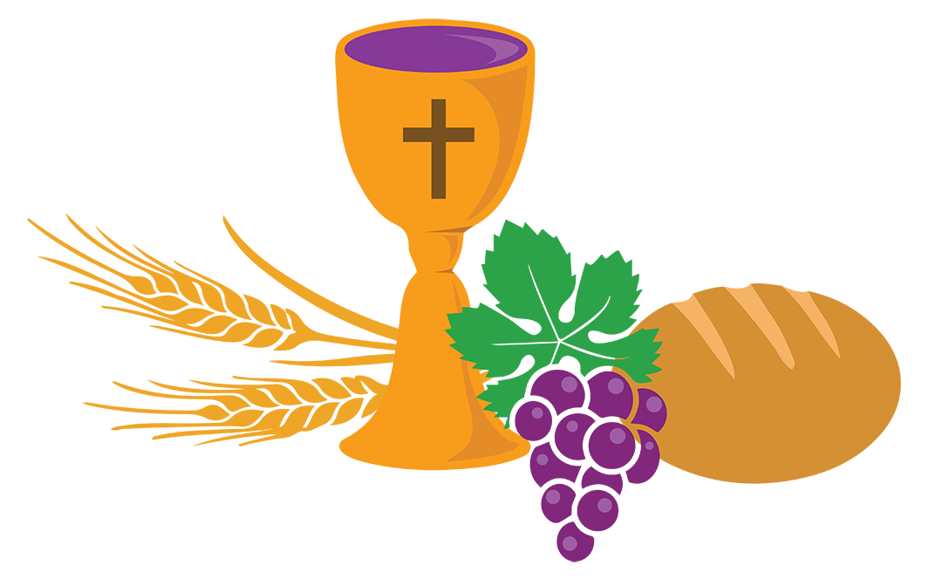
“I Am”
The statement, “I Am”, only found in John
“I am the bread of life"

Slide 8
The Book of Glory
Different focus in the Last Supper
Long speech by Jesus
“Whoever has seen me has seen the Father” (John 14:9)
“I am in the Father and the Father is in me” (John 14:10)
“No one has greater love than this, to lay down one's life for one’s friends” (John 15:13)

Slide 9
The Holy Spirit
Described in John as a “parakletos”
“I will ask the Father, and he will give you another Advocate, to be with you forever. This is the Spirit of truth, whom the world cannot receive, because it neither sees him nor knows him. You know him, because he abides with you, and he will be in you” (John 14:16-17)

Slide 10
The Resurrection
Mary discovers the empty tomb, followed by Peter and John
Jesus appears to the disciples that night
“Peace be with you. As the Father has sent me, so I send you.”
“Receive the Holy Spirit”
“Blessed are those who have not seen and yet have come to believe” (John 20:29)

Slide 11
Final Chapter
Disciples encounter Jesus on shore
Conversation with Peter
“But there are also many other things that Jesus did; if every one of them were written down, I suppose that the world itself could not contain the books that would be written” (John 21:25)

Slide 12
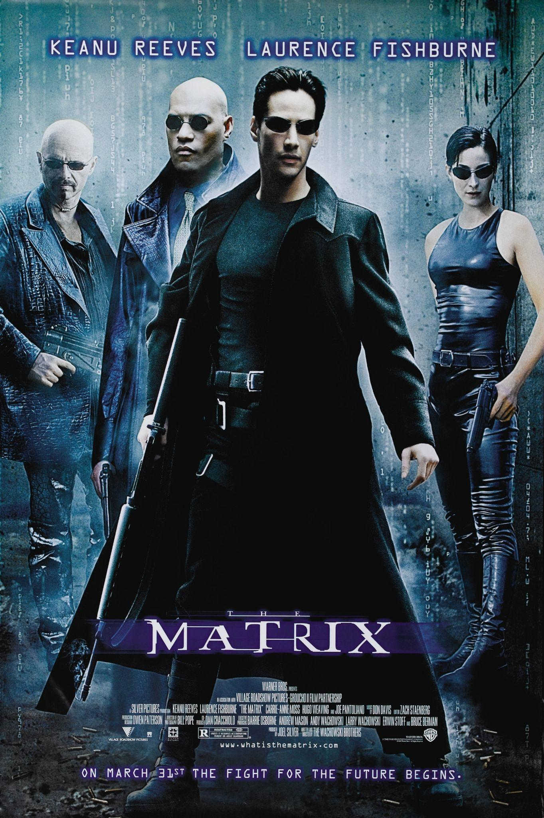
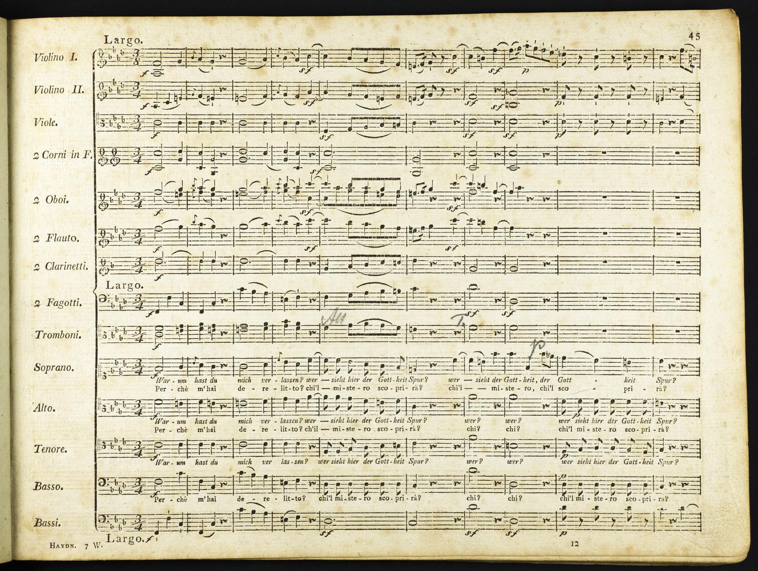
Cultural Connections
The Matrix
“And you will know the truth, and the truth will make you free” (John 8:32)
The Seven Last Words

