Slide 1
The Bible and Its Influence Chapter 21: Mark
Kristen & Alejandro

Slide 2
Prologue
Each gospel in the Christian Bible was tailored towards its anticipated readership
Mark’s has a “newspaper feel” to it and is the most journalistic out of the four gospels
  Especially since it is the shortest gospel
Begins with the public life of Jesus and a clear statement of Jesus’ identity:
  “The beginning of the good news of Jesus Christ, the Son of God” (1:1)
John the Baptist is the first character to appear
  Mark introduces John under that implication that he is the messenger from Hebrew Scriptures “As it is written in the prophet Isaiah, ‘See, I am sending my messenger ahead of you…’” (1:2)
Jesus is introduced right after John, and the scene depicts Jesus’ baptism, where he sees the “heavens torn apart and the Spirit descending like a dove on him” (1:10)
  “You are my son, the Beloved…” (1:11)

Slide 3
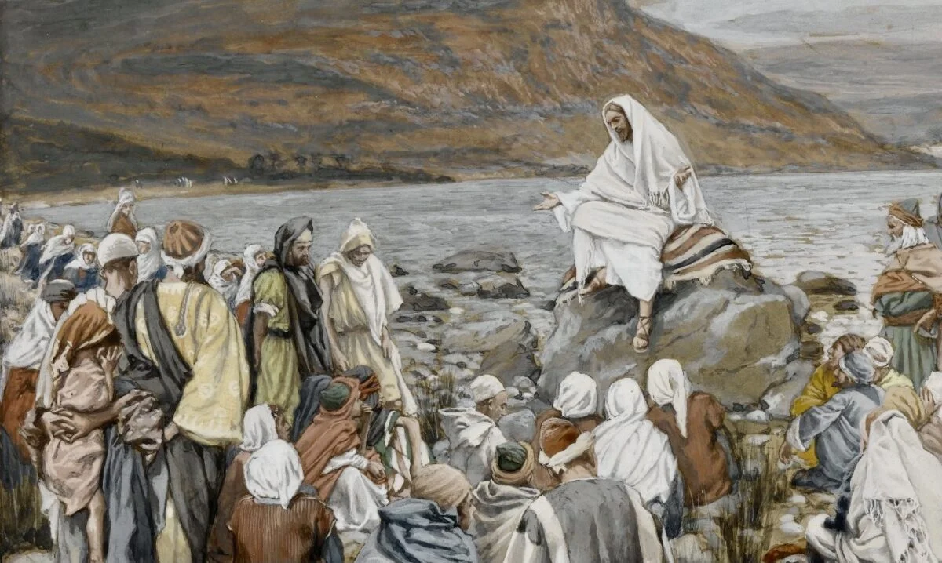
Public Life of Jesus
The first chapter introduces 3 actions which Jesus is associated with: teaching with authority, healing, and exorcism
  There are more exorcisms in Mark than any other gospel
Jesus was accused of committing blasphemy by scribes who witness Jesus healing a paralyzed man
  “Who can forgive sins but God alone?” (2:6)
Chapter 4 concludes with a “nature miracle”
  Jesus commanded the wind “Peace! Be Still!” (4:39)
https://www.psephizo.com/biblical-studies/the-nature-of-jesus-ministry-in-mark-6/

Slide 4
Narrative within the Narrative
Distinct use of parataxis in the narrative style
  Multiple sentences beginning with “And”
The narrative begins with one story like Jesus’ teachings, but is interrupted by another story (the exorcism)
  Called intercalation, or the sandwich technique
Concludes by returning to the original story of teaching
Overall, teaching is Jesus’ priority throughout the narrative of this gospel
  “As he [Jesus] went ashore, he saw a great crowd; and he had compassion for them… and he began to teach them many things.” (6:34)

Slide 5
A Transfiguration
-Chapter 9 discusses how Jesus and three of his closest followers went up a mountain and in Marks words,
-“And he was transfigured before them, and his clothes became dazzling white, such as no one on earth could bleach them. And there appeared to them Elijah with Moses, who were talking with Jesus” (Mark 9:2-4).
-Next from the heavens above a voice was heard saying,
-“This is my Son, the beloved; listen to him!” (Mark 9:7).
-After this experience, Jesus talks to the three present disciples about the resurrection and tells them to not say a word of what they heard or saw until after “The Son of Man” has resurrected.

Slide 6
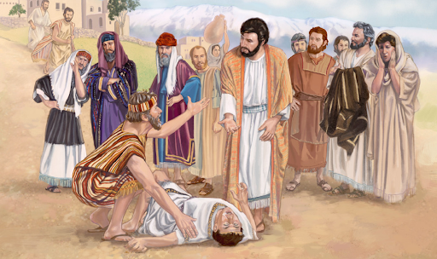
Up to Jerusalem
-Following the transfiguration, Mark gives us an example of the theme of belief vs. unbelief.
-A father arrives with his son in front of Jesus
And asks for help since his disciples failed to.
-Jesus states anything is possible for those
who believe.
-The father then exclaims, “I believe; help
my unbelief!” (Mark 9:24)

Slide 7
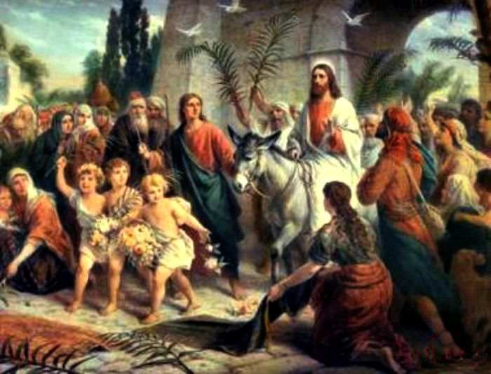
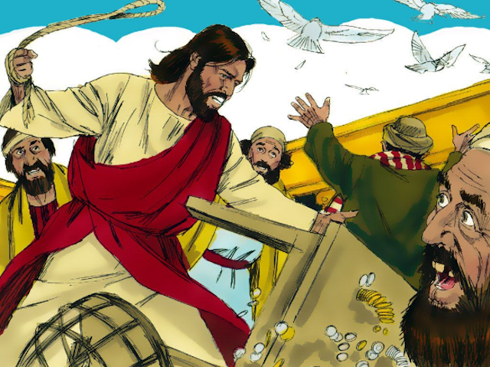
The Final Week
-Chapter 11 starts with a narration of Jesus’ final week of life. Beginning with his arrival to Jerusalem on a colt, people spread their cloaks and branches before him.
-The next day, the happy tone shifts to anger as when Jesus goes to the temple there are a lot of merchants whose tables are quickly turned over.
-Later in chapter 14 Jesus’ trial and execution happens where Mark gives his version of the last support then they go up a mountain and Jesus is arrested. He is later crucified and dies.

Slide 8
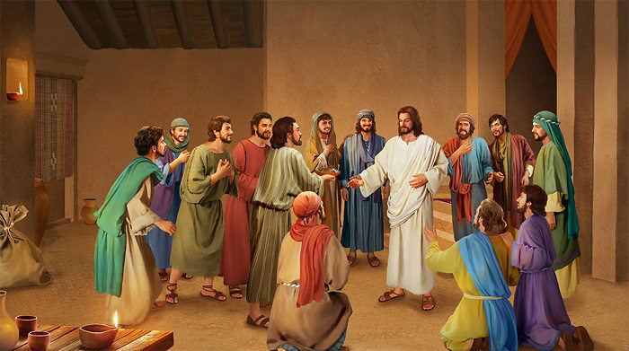
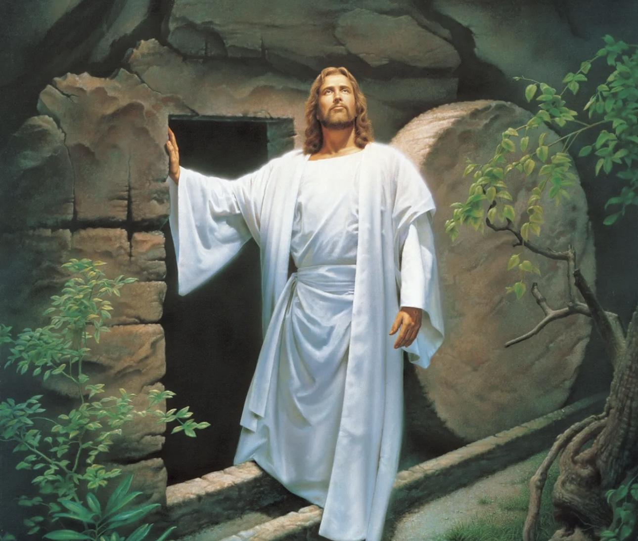
An Empty Tomb
-The gospel of Mark finished rather abruptly. Chapter 16 discusses the resurrection of Jesus as well as his appearance before the disciples.
-There appears to be two endings. A short one that ends with verse 8 an a longer one that goes to verse 20.

