Slide 1
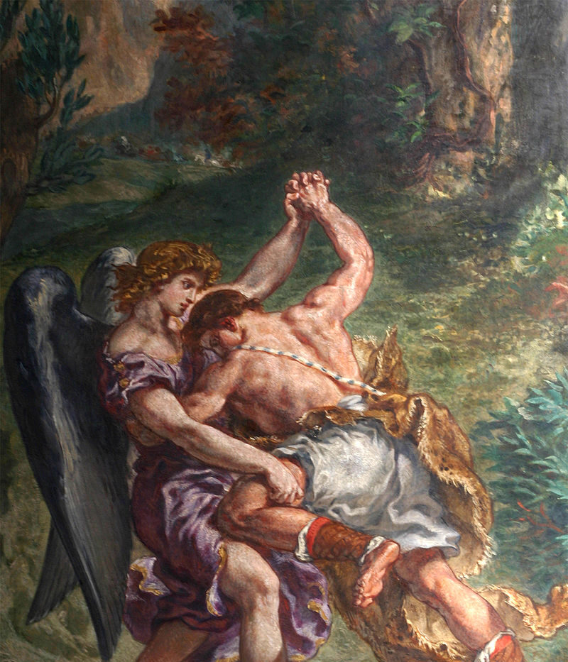
GOD WRESTLING-
JACOB’S WRESTLING
GENESIS 32:22-23

Slide 2
THE JACOB STORY
. Jacob son of Isaac and Rebecca.
. Jacob stole his brother Esau Blessings, he was getting from Their father.
. When Esau found out he vowed to kill him. Jacob flee away. That same night he had a dream, he saw a ladder that reached from heaven to earth and saw God’s angels ascending and descending upon it. God appeared to Jacob in the dream and said to him “I am with you, I will not leave you. You will have land and a nation.”

Slide 3
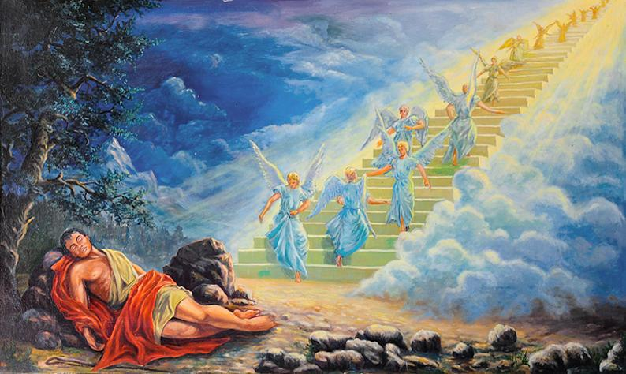

Slide 4
JACOB WRESTLING MATCH
. After 20 years, Jacob decide to return to his father land, to face Esau for the first time since he cheated him out of his blessing. On his way he heard his brother Esau was coming with 400 men. Jacob prayed to God that Esau won’t destroy him and his children. He sends his wives and servant to the other side of the river and he stayed alone.
. This night Jacob wrestled with a stranger till the break of day. The stranger knew he could not prevail, so he asked jacob to let him go. Jacob refused and said to him “i will not let you go, unless you bless me.” The stranger asked Jacob for his name and changes his name to Israel.
.“You have wrestled with God and man and have prevailed.”
. Jacob named the place where he received his blessings, Peniel. Which means which means I have seen God face to face, yet my life has been saved.

Slide 5
INSIGHTS
. “Before Jacob, we’re finding mostly characters are pretty one dimensional. They pretty much do what God says and may protest a little here and there, but in Genesis, this is, aha, someone who’s human, the first real, human person.” -Renita Weems.
With Jacob the sinful nature of man and the complexity tendency of man is shown. It is intriguing God showed grace and mercy towards him with promises, after what he had done to his brother.
. “But the thing we struggle with is our own myth of perfectibility, that somehow because Jacob has had an encounter with God, which does change him, that our expectation is that he is to be all of a sudden a perfect person. And I think the story tells us that the encounter with God changes us but not to perfection. We are still human. We still bear the marks of everything that we are, but he is a different man.” - Roberta Hestenes
This shows our encounter or experience with God, does not mean life will become perfect or Become perfect human beings change will happen, but i will sinful nature will always show itself.

Slide 6
INSIGHTS CONTINUED
“ Nothing about Jacob changes. In a way, that’s what’s so depressing. Despite the fact that he has a dream as a young man, he has a young man’s dream, and as a middle aged man, he has a middle aged man’s dream, his habits remain the same. He does not change.” -Burton L. Visotzky
  Did he truly not change?
    Outwrestled someone beyond human comprehension
“We always refer to Jacob wrestling with the angel. That’s not what the text says. The text says Jacob wrestled with a man. And I think this is something that we have to recognize in Genesis continually. It’s very hard to know when a man is a man, when a man is an angel. And to make it more complicated, it’s hard to know when an angel’s an angel and when an angel is, in fact, God.” -Burton L. Visotzky
  Internal struggle?
  Did the angel allow Jacob to last for hours and win?
“I think there’s no doubt of that becomes right before the dream in one verse, the word ‘face’ is used five times with reference to Esau, and after the dream he says to his brother, ‘seeing your face is like seeing the face of God.’ So if you take the context —” -Walter Brueggemann
“And the name of the place that he had the struggle, Peniel, to face of God.” -Burton L. Visotzky
  Esau seems to be somewhat on God’s good side despite being Godless at first

Slide 7
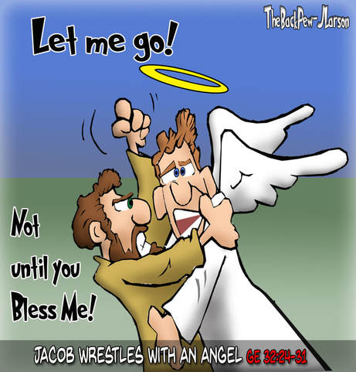
The End

