Slide 1






Wisdom
The Bible and Its Influence Chapter 14
Avery Tubach

Slide 2
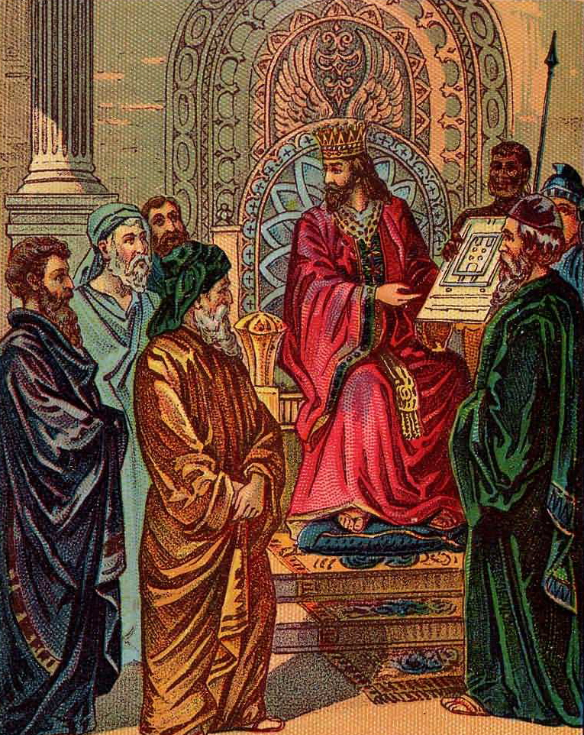
Proverbs
Attributed to King Solomon
1 Kings credits him with 3000
Words of wisdom in concise statements
Rules to live and govern by
Most widely quoted book of the Bible
“Those who spare the rod hate their children, but those who love them are diligent to discipline them” (13:24)
“Like a dog that returns to its vomit is a fool who reverse to his folly” (26:11)
https://en.wikipedia.org/wiki/Solomon#/media/File:Solomon_and_the_Plan_for_the_Temple.jpg

Slide 3
Structure
Parallel Line Structure
Stress differences between wisdom and folly
Ex. “The wise man [does something] / But the fool [does something else]”
Parable
Teaching story
6:6 “lazybones”
“Biblical embodiment of foolishness”
Central message of Proverbs is that wisdom comes from respecting and fearing God

Slide 4
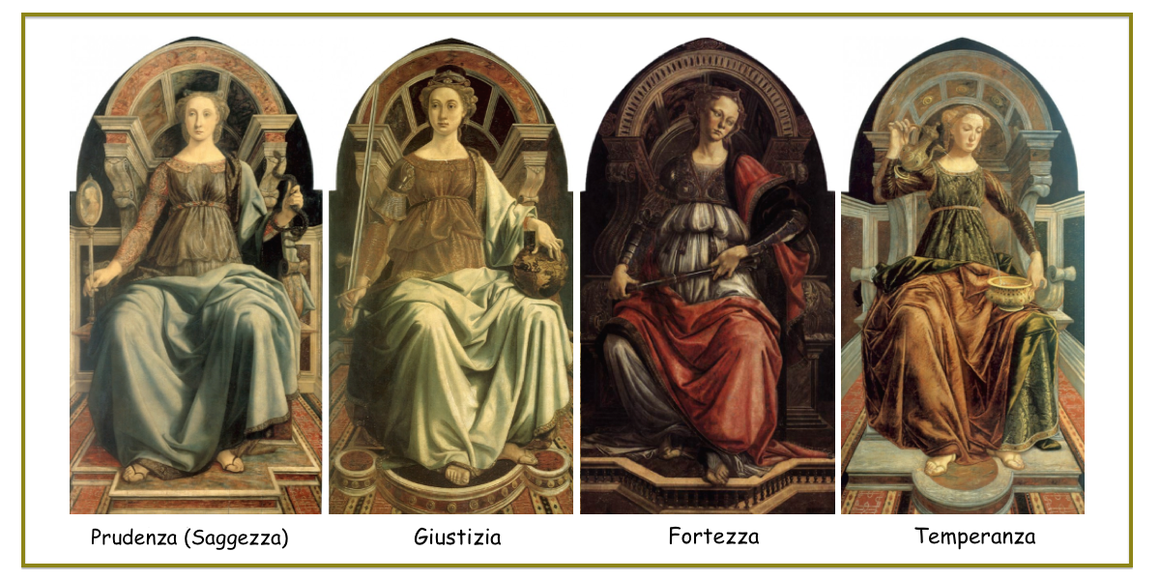
Cardinal Virtues
Foundation for moral behaviors, depicted as female
Prudence, Justice, Fortitude, Temperance
https://www.weswhite.net/2022/05/the-four-cardinal-virtues-part-1-prudence-justice/

Slide 5
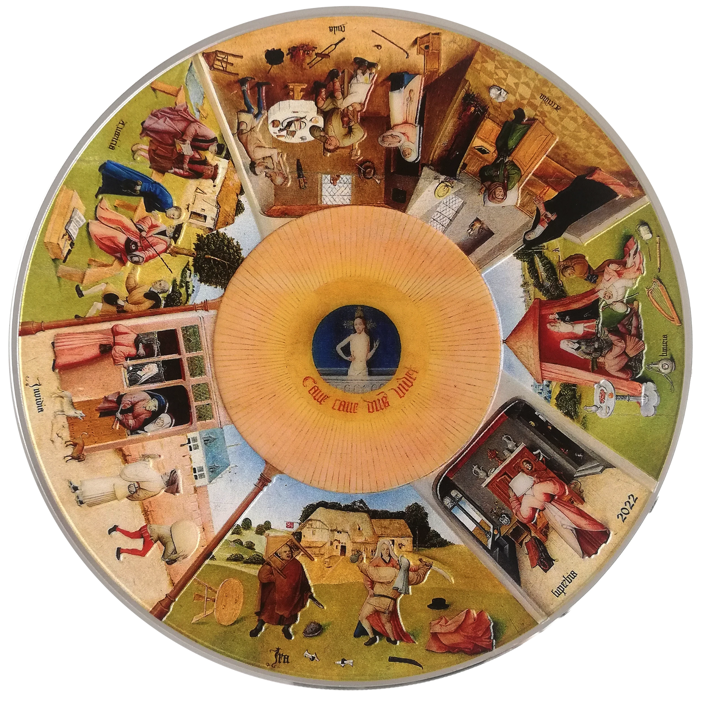
Deadly Sins
Pride- inflated sense of self- worth
Envy- yearning and resenting what others have without looking at what one has
Anger- unjustified rage or violence
Lust- sexual appetite or illicit sexual behavior
Sloth- spiritual and intellectual laziness, lack of will
Avarice- unjust taking of material goods or money
Gluttony- overindulgence of food and drink
Painted tabletop by Hieronymus Bosch for King II of Spain

Slide 6
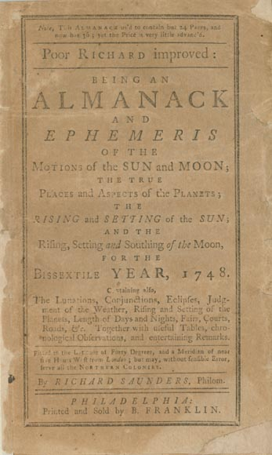
Influences
Poor Richard’s Almanac
Annual publication of advice by Benjamin Franklin
Published from 1732-1757
“Early to bed and early to rise, makes a man healthy, wealthy, and wise”
“Don’t throw stones at your neighbors, if your own windows are made of glass”

Slide 7
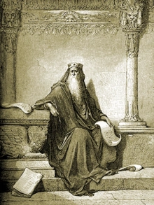
Ecclesiastes
Koheleth
Emphasis on Death
Book is attributed to Solomon but the speaker is Koheleth
Most modern feeling book of the Bible
Gathers wisdom through observation and error
Questions of justice, meaning, and the creation of happiness
Immortality through the afterlife was not yet a concept
Life is short and death ends your existence
Dead go to Sheol
Koheleth stresses finding meaning in life through enjoying the gifts of life and relationships

Slide 8
“There is nothing new under the sun” (1:9)
“Surely there is no one on earth so righteous as to do good without ever sinning” (7:20)
“So I commend enjoyment, for there is nothing better for people under the sun than to eat, and drink, and enjoy themselves, for this will go with the in their toil through the days of life that Gods gives them under the sun” (8:15)

Slide 9
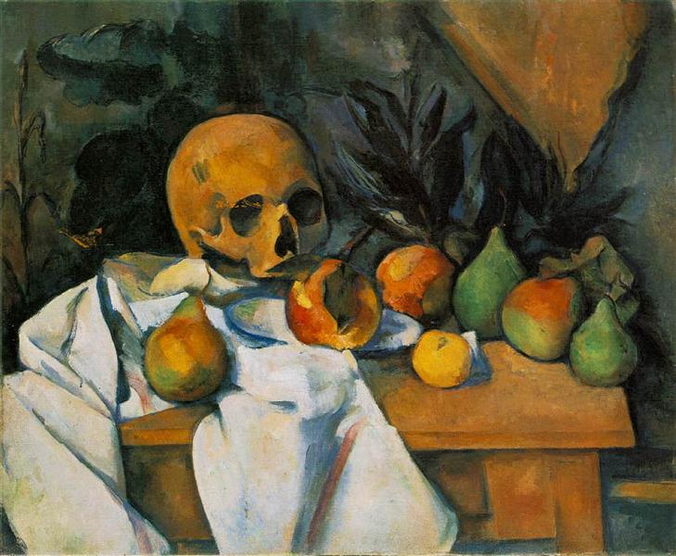
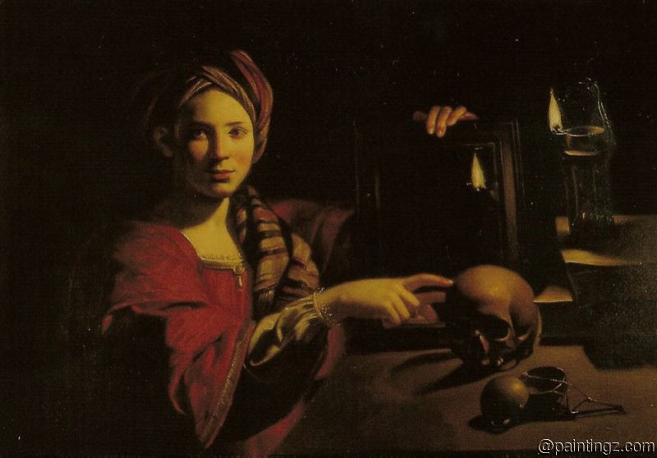
Influences
Inspired the genre of memento mori (remember mortality) paintings
Still Life with Skull, Paul Cezanne
Allegory of Vanity, Trophime Bigot

Slide 10
Song of Songs
Let him kiss me with the kisses of the mouth! For your love is better than wine!
I am black and beautiful, O daughters of Jerusalem, like the tents of Kedar, like the curtains of Solomon
I am a rose of Sharon, a lily of the valleys.
He brought me to the banqueting house, and his intention toward me was love.
(Song of Songs 1:2, 5; 2:1, 4, 10)
Dialogue between a lover and beloved
Perspective shifts between the two
Explicit representation of erotic love

Slide 11

Interpreting Song of Songs
Love story
Judaism celebrates the body as God’s creation
Marital sexuality as an example of the covenant between God and humans
Incorporated in Jewish and Christian wedding ceremonies
Metaphor for God’s marriage to people
Allegory of love/marriage between God and people of Israel
OR
God and the Church
OR
God and human souls
Interpretations differ due to God not appearing in the text

Slide 12
Thank you!

