Slide 1
The Bible and Its Influence
Chapter 5: Ancestors
Genesis 24-50
By: Arielle Shioli & Maricela Padilla

Slide 2
Blessing & Deception
Esau and Jacob are born to Rebekah and Isaac, son of Sarah and Abraham.
They were born as twins, with Esau being named such because he was “hairy.”
Esau came back from a hunt one day, apparently starving, and Jacob is cooking lentil stew
Esau demands Jacob share the stew
Jacob demands Esau’s birthright as the firstborn son
Esau, convinced he’s starving, agrees and sells his birthright for the stew.
He does indeed get the stew, it probably wasn’t worth it.
Esau married two women, Judith and Basemath, and they apparently made his parents lives a nightmare. (Rebekah calls them the “Hittite women.”)
Ironically, Jacob himself will later be deceived in his marriages with Leah and Rachel.

Slide 3
The Dream
Jacob is given a dream from God: “Look up and see that all the goats that leap on the flock are striped, speckled, and mottled; for I have seen all that Laban is doing to you…”
Jacob and his family have to leave Laban’s home, but Rachel steals the idols of her father’s household and takes them with her.
When Laban follows them, asking to get them back, Rachel hides them in her camel’s saddle and sits on them, claiming she can’t stand up because she’s menstruating.
Jacob is angry at Laban for being falsely accused. He and Laban make a covenant with God as their witness: Jacob will take no other wives, and neither will cross into the other’s lands.

Slide 4
The Reunion
Now homeless, Jacob seeks to return to his brother Esau, who is now a lord.
Hoping to appease his brother, he sends several waves of his livestock forward first.
Jacob sends his family forward across the river, but is stopped by a strange man who suddenly attacks him. (More on the Wrestling Match)
Once Jacob is renamed Israel, he reunites with his brother, who has forgiven him and embraces him and offers him his help.

Slide 5
The Wrestling Match
Jacob, while wrestling the unnamed man who attacked him, is clearly winning the match until the man decides to fight dirty and dislocated Jacob’s hip.
Even then, Jacob holds on long enough that the man gets nervous about the approaching sunrise.
It’s at this point the man reveals himself to be an angel, and he renames Jacob as Israel. Jacob continues to go by Jacob until late in the story, when God reaffirms this.
The story of wrestling an angel mirrors other stories of heroes wrestling with divine figures: e.g. Heracles wrestling the Nemean Lion.

Slide 6
Joseph the Dreamer
Joseph is the favorite! And brother, nobody likes that.
Joseph, Jacob’s son, doesn’t get along with his brothers. When he has a dream about how he will be successful and they will serve him, they really don’t get along.
His brothers attempt to kill him without blood, but when that fails, they attempt to sell him into slavery, but find that Joseph is gone.
Jacob, thinking his son was killed by a wild animal, mourns him bitterly, and misfortune befalls all the brothers.
Joseph goes on to earn the trust of the Pharaoh of Egypt.

Slide 7
Structure & Meaning
In Joseph’s narrative, there are three sets of dreams & each set consists of two dreams
  The two dreams for each set focus on the same theme
  Dreams follow the rise & fall, and eventual rise of Joseph
Joseph’s story is reflective of previous narratives in the Genesis
His narrative also offers a more dramatic depiction of the major recurring themes of the Genesis:
  God’s intervention in human lives to bring deliverance
  Blessings
  Salvation

Slide 8
Israel’s Children
In the closing of Genesis, Jacob, now old and losing his eyesight like his father Isaac, blesses Joseph’s two sons inverting the traditional birth order
  Joseph’s initial protests to his sons being blessed results in his youngest, Ephraim, being given the birthright that is usually reserved to the oldest son
The rest of Jacob’s sons are blessed according to their deeds
  These sons’ offspring would become the sources for the twelve tribes of Israel
The twelve tribes of Israel:
  Jacob & Leah’s sons: Reuben, Simeon, Levi, Judah, Issachar, Zebulun
  Jacob & Zilpah’s sons: Gad & Asher
  Jacob & Bilhah’s sons: Dan & Naphtali
  Jacob & Rachel’s sons: Benjamin
    From Joseph & Asenath’s sons: Manasseh & Ephraim
Genesis ends with prosperity, but turns into conflict between the tribes and kingdoms that descended from Abraham in the Book of Exodus

Slide 9
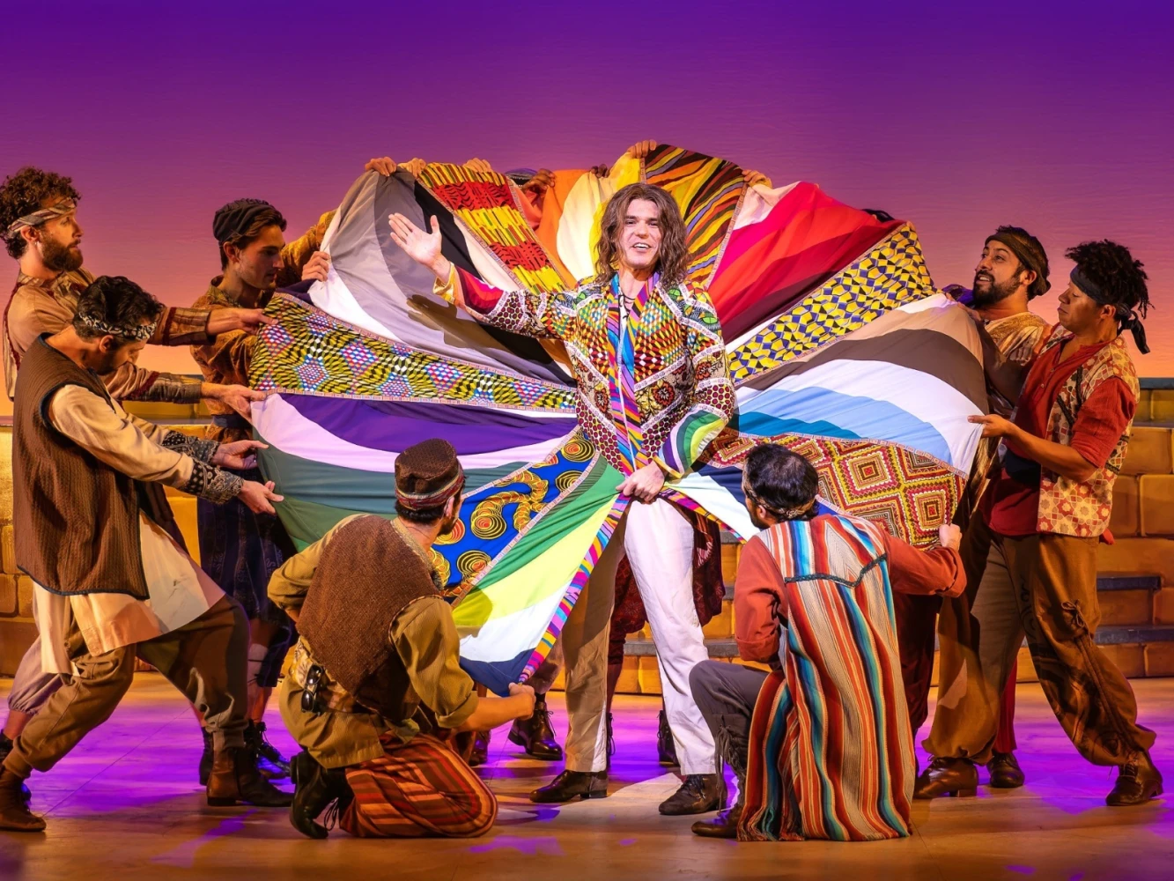
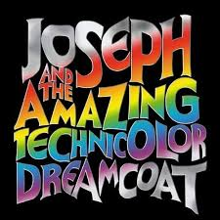
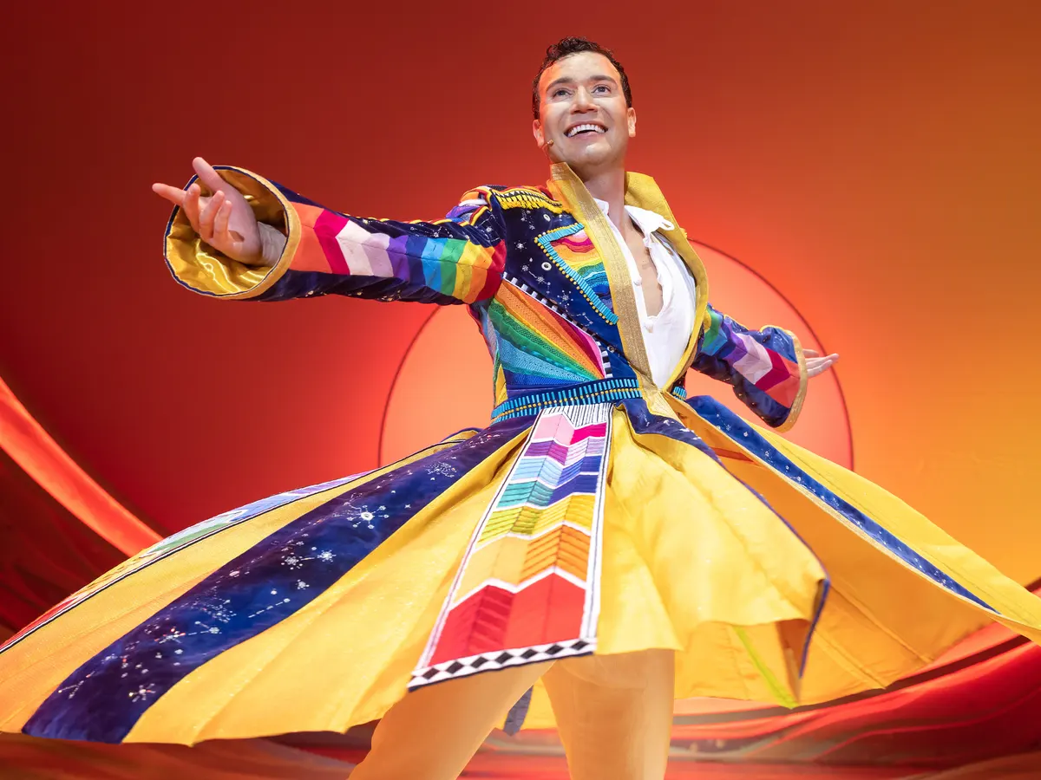
Cultural Connections
A musical titled Joseph and the Amazing Technicolor Dreamcoat by Andrew Lloyd Webber & Tim Rice retellsl the story of Joseph. It is a “humorous and modernized approach to the Genesis” and it is frequently performed in theatres and schools.

Slide 10
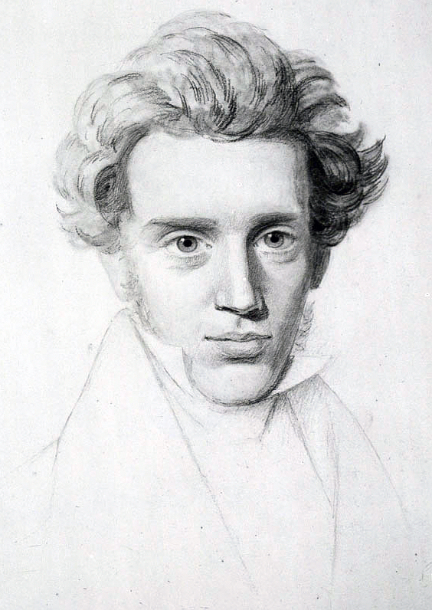
Influence: Kierkegaard
Father of existentialism philosophy
Focused on the interpretation of Abraham’s near sacrifice of his son Isaac, calling him a “knight of faith”
In his work, Fear and Trembling, he says, “Faith is a marvel, and yet no human being is excluded from it; for that in which all human life is united is passion, and faith is a passion”

Slide 11
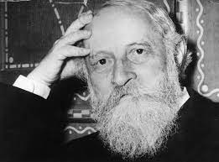
Influence: Martin Buber
A German Jewish philosopher & a biblical translator and interpreter
Focused on the dialog that people have with one another & ultimately with the divine
Also looked at the akedah, or the binding of Isaac, but viewed this as part of Abraham’s journey to the land of promise
  He believed that Abraham had idolized his son & so in offering Isaac to God he began to straighten his priorities, therefore becoming the “parent of a great nation”

Slide 12
Influence: Wilfred Owen
He was enlisted in the British army in WWI
In his poem, “The Parable of the Old Man and the Young,” he condemns the war, especially the elderly diplomats, generals, and government leaders
In the poem Abraham is symbolic representation of those elderly diplomats, generals, and government leaders of WW1, while Isaac is the symbolic representation of those young men that are in the war
In the poem, Abraham:
  binds Isaac
  builds parapets and trenches
  neglects the angel who tells him to not kill Isaac
Closing lines of the poem: “But the old man would not so, but slew his / son, / And half the seed of Europe, one by one.”

