Slide 1
Self-Identity Amid Societal Pressures
Brianna Gier

Slide 2
Understanding self-identity versus societal expectations is crucial for teens, as it helps them navigate the often conflicting pressures of who they are and who they are expected to be. During adolescence, individuals are in a pivotal phase of self-discovery and development. They are forming their values, beliefs, and sense of self, all while being bombarded with societal norms and expectations. Books like "Jane Eyre” by Charlotte Bronte and "I Am Not Your Perfect Mexican Daughter” by Erika Sánchez offer powerful narratives highlighting these struggles. These stories provide a mirror for teens, reflecting their own experiences and challenges in a way that is both relatable and enlightening. Through the characters' journeys, readers can see the importance of authenticity and the courage it takes to stand up for one's true self.

Slide 3
By reading about characters who grapple with similar issues, teens can gain insights into their own lives and feel less isolated in their struggles. This understanding fosters resilience and self-acceptance, which are crucial for navigating the often tumultuous teenage years. Ultimately, literature exploring self-identity versus societal expectations not only entertains but educates and empowers teens to be true to themselves.

Slide 4

Simon vs. The Homo Sapiens Agenda. By
"Simon vs. the Homo Sapiens Agenda" by Becky Albertalli is a heartfelt and humorous novel that explores self-identity and the journey of coming out as a gay teenager. The story centers on Simon Spier, a high school junior who is not openly gay and prefers to keep his sexuality a secret. However, when an email falls into the wrong hands, Simon must step out of his comfort zone and navigate the challenges of coming out to his friends and family. The novel delves deeply into themes of self-acceptance, the fear of being different, and the courage it takes to be true to oneself.

Slide 5


Darius the Great is Not Okay by Khorram, Adib.
A touching novel that delves into identity, mental health, and cultural heritage themes. The story follows Darius Kellner, a half-Persian, half-American teenager who struggles with clinical depression and feels like an outsider both at school and within his own family.
Jane Eyre by Charlotte Brontë
is a cannonical novel that delves deeply into the themes of self-identity, independence, and moral integrity. The story follows the life of Jane Eyre, an orphaned girl who faces a series of trials and tribulations from childhood to adulthood. Despite the hardships and societal expectations of the Victorian era, Jane remains steadfast in her principles and sense of self.

Slide 6
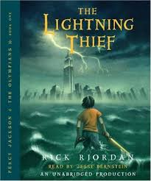
Lightning Thief by Riordan, Rick.
"The Lightning Thief" by Rick Riordan is the first book in the Percy Jackson & the Olympians series. It follows the adventures of Percy Jackson, a twelve-year-old boy who discovers that he is a demigod, the son of Poseidon, the Greek god of the sea.
Throughout his journey, Percy faces numerous challenges and monsters from Greek mythology. He is joined by his friends Annabeth Chase, the daughter of Athena, and Grover Underwood, a satyr. Together, they navigate various trials and discover the importance of friendship, bravery, and self-acceptance.

Slide 7
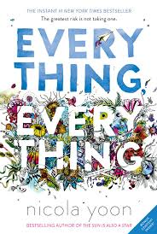
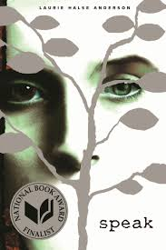




More YA Novels about Self-identity and discovery

