Slide 1
Effects of Age and the Trauma:
Unit of Study
By Antonio Munoz

Slide 2
Rationale:
Children at young age are hidden from the reality and are told small lies that protects them from the truth of being hurt.
Children are protected from there guardians and parents from all of the cruelty that there is because their is a lot of ignorance and violence.
With age it allows the people who are in trauma like children to mature and form their own opinions and find their own ways to become better.
Every single case is different but through trauma reading books about characters who have gone through similar experiences can be helpful to children and adults.
Every person of each age is different but with experiences of the characters they can be able to become the better person they are and the person that they are today.

Slide 3
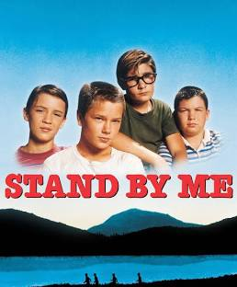
Introduction to the Unit
To begin the Unit my students will watch the Film “Stand
by me .”
I choose this film Because it is a great example of trauma and
the issues that a kid faces with the relationship with his father
and also because he meets someone who is Homeless and they
Share the different traumas that they both have one living in a
nice home and someone living in the streets.
Starting the unit with a film can help the class prepare them for
What to expect on what's coming next in the class, and can also help
Them get a better understanding of the unit.

Slide 4
After the Film
After the Film I would have my students answer some questions regarding the film and the book.
What are the differences of the book and film?
Can you relate to one of your favorite character if have one or more than one character?
Is it your first time watching this film, If not do you see something different watching it for a second time?
All of these questions will in come handy because I would have my students at the end of the unit write a paper about the film or the book. And with these questions I can have my students think about more of the back message of the film.

Slide 5
Before reading the book:
Before we Start to read the book I want to ask my students if they have had some experiences where they have felt that they have developed has a person or felt more mature than other times.
I would also ask them a question like if they have ever watched a film or read, that they think that they belong in this group.
I would also have them maybe brainstorm on a piece of paper where they've had an experience that they have had of maturity.

Slide 6
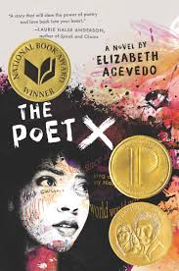
Presenting the Novel:
I Decided to chose this Novel because it is a great example
of a little girl who is understanding the way her mother is and she
wants that her relationship to grow.
This novel is about Coming-of-age and for these little girl
to be able to find her voice however it is.
Ximora Eventually finds herself and her voice has she grows
Up and realizes that writing poetry it's what makes her happy.

Slide 7
Working With the Novel:
When presenting to the novel to the class, we would work in class reading the book and maybe assigning to read the novel at home.
As we work through the text I would focus on presenting the Character Ximora and how she goes through her journey and discovers the slam of poetry. Also she explores the themes such has how important is family and religion and the dynamics of expression has a young latina girl.
I would also use some of the poems that are in the book to engage my students and ask them questions about experiences of identity and when they have had moments of coming-of-age.
I would also give them a paper of homework when reading a few pages each night i’ll like my students to write a few sentences of what they understood for each reading section they read.

Slide 8
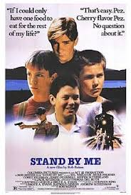

To End the Unit:
To finish the unit off, I would give my students two essay prompts and its
For them to decide which essay they chose to do. First they will have to write
about their trauma and how they have been traumatized before in their lives
and how that has helped them to grow and mature has a young person.
The second option will be on the novel how they liked the novel and how they
Can relate it to themselves, and experiences that they have had in the past.

Slide 9
Thank You!

