Slide 1
Strong Female Characters
Unit of Study by Ana Hahs

Slide 2
"A woman with a voice is, by definition, a strong woman."
~Melinda Gates~

Slide 3

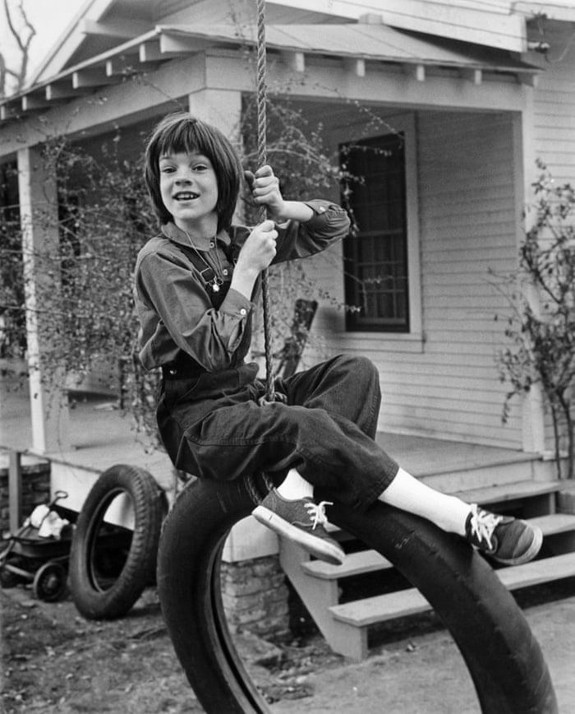

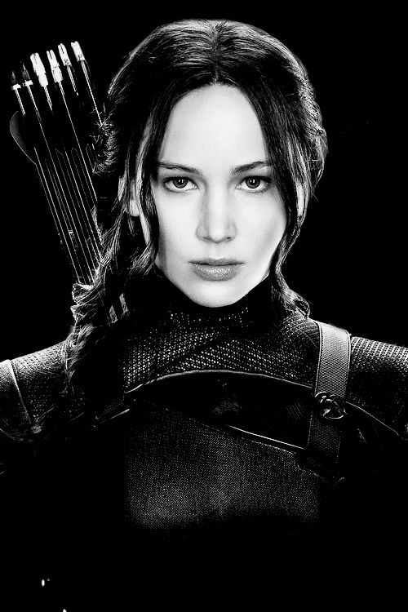
Scout Vs. Katniss

Slide 4
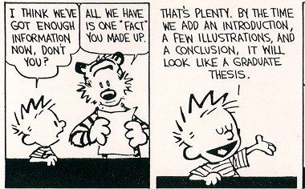
Reflection Paper
Look at the one-line definition of a strong female character.
Do you still agree with it? Why or why not?

Slide 5






Slide 6
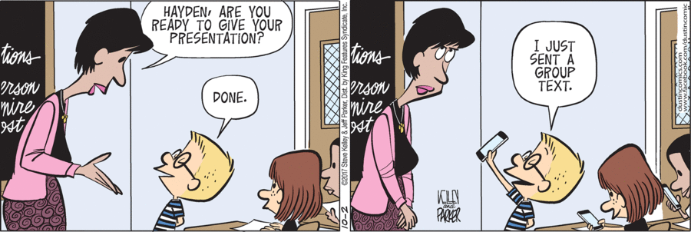
Presentation Project
Students will divide in groups and “teach” one of the books listed to the class
They must decide if the main character is a “strong female character”
There will be a “creative element”
Five question quiz
Q&A session

