Slide 1

A Unit of Study on Inspirational Literature
By Alen He

Slide 2

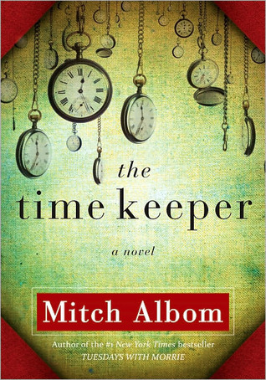
The Time Keeper
By Mitch Albom
The inventor of the world's first clock is punished for trying to measure God's greatest gift. He is banished to a cave for centuries and forced to listen to the voices of all who come after him seeking more days, more years. Eventually, with his soul nearly broken, Father Time is granted his freedom, along with a magical hourglass and a mission: a chance to redeem himself by teaching two earthly people the true meaning of time.
He returns to our world - now dominated by the hour-counting he so innocently began - and commences a journey with two unlikely partners: one a teenage girl who is about to give up on life, the other a wealthy old businessman who wants to live forever. To save himself, he must save them both. And stop the world to do so.

Slide 3

What is Inspirational Literature?
Offers young adults the chance to not only understand themselves, but the world around them as well
Encompasses all the good, bad, and ugly situations of life
Grants the ability to view life through the perspectives of people who have gone through, or are going through, difficult times
Helps guide people through their journeys for the pursuit of happiness
Allows people to learn about themselves, other people around them, and the reality that they live in

Slide 4


Focuses of Inspirational Literature
Confronting daily struggles
Challenging professional and personal problems
Resolving physical and emotional conflicts
Finding a purpose to continue striving for happiness
Exploring readers’ emotions and imaginations
Understanding the importance of life and purpose

Slide 5


Introducing the Unit
Brief free-writing session (15-20 minutes)
Prompt: something they want vs. something they need
Explain if/why one is more important than the other

Slide 6

Guiding Questions
Do the things you want or need have to be physical?
What is the difference between wanting something and needing something?

Slide 7

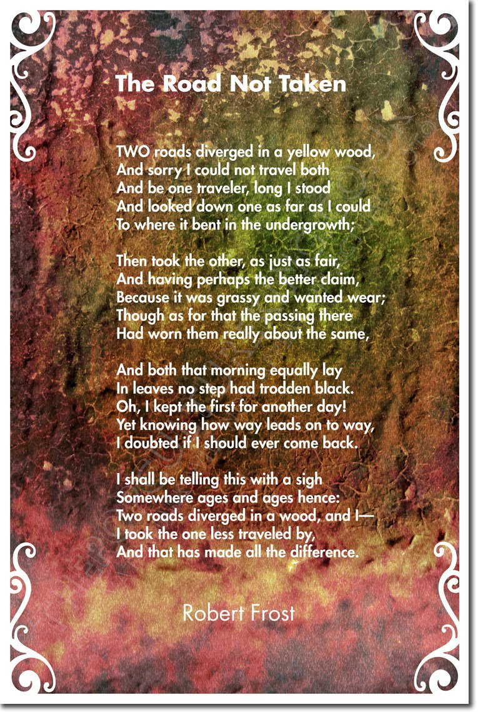


Slide 8


Centerpiece
Which character do you relate to the most? Why?
What is your definition of happiness? Can happiness be bought? Why or why not?
What is something that inspires or motivates you? Why is inspiration or motivation important?

Slide 9
Extending the Unit: EDEN - “rock + roll”
EDEN - "rock + roll"

