Slide 1
Poetry Unit of Study
Malorie Allen

Slide 2
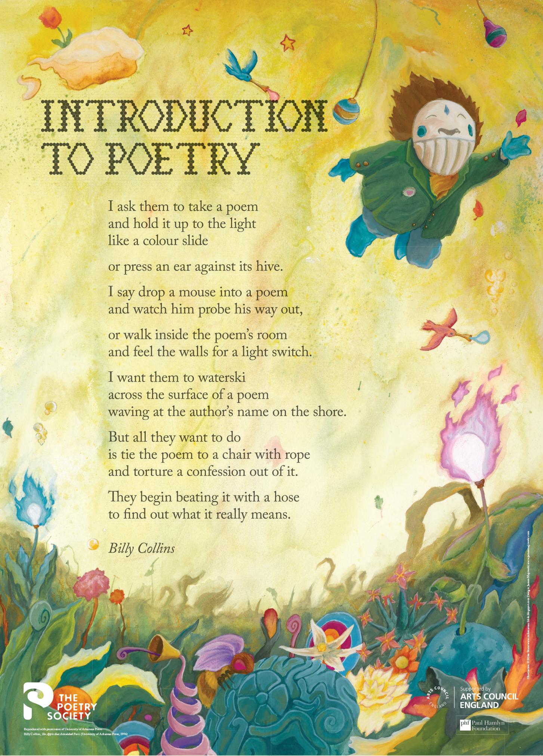
Introduction to Poetry by Billy Collins
http://poetrysociety.org.uk/wp-content/uploads/2015/03/PSPosters-Collins.jpg

Slide 3

Black Out Poetry
https://www.pinterest.com/explore/blackout-poetry/

Slide 4

Robert Frost
https://www.youtube.com/watch?v=89dSwSmG6ks

Slide 5

Robert Frost
https://www.pinterest.com/ajnosecurb/the-road-not-taken/

Slide 6
Final Project
The final will be composed of quotes from each poem we have discussed in the classroom and the students must identify the title, author, and poetic devices used in the particular poem. After they have identified the poems they will be asked to compare and contrast the two Robert Frost poems. The students must connect their ideas to the overall theme of the unit: different perspectives. Their response must be at least 1-2 pages in length and incorporate their new poetic vocabulary terms. Lastly the students will be given famous couplets from Shakespeare and asked to scan the couplets and label which ones are using iambic pentameter.

