Slide 1
Female Narratives in Historical Contexts
Beverly Pace

Slide 2
Why is it important to support female narratives in historical contexts?
Girls and women are being underrepresented in film, tv, and literature.
Women are, “victims of war. Women lose their husbands, their fathers, their sons in combat. Women often have to flee from the only homes they have ever known. Women are often the refugees from conflict and sometimes, more frequently in today’s warfare, victims” - Hillary Clinton
Literature and media that focuses on the female perspective in historical contexts helps paint a larger, more inclusive picture.
Girls need access to strong, dynamic, relatable role models/characters

Slide 3
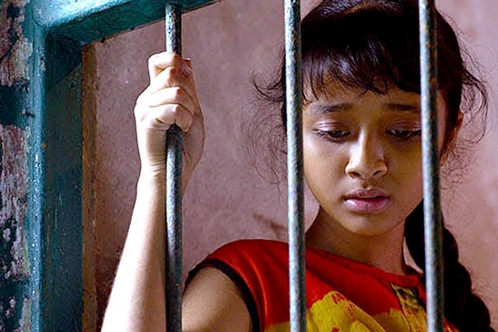
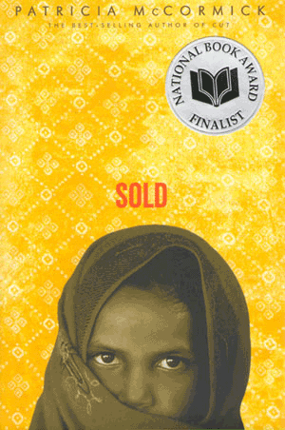
Sold by Patricia McCormick
Patricia McCormick on Sold: When Patricia McCormick was asked why she wrote Sold in vignettes, she said it was “too daunting to imagine that I could tell Lakshmi’s entire story in whole.” After the author visited India and Nepal to research her book she said her biggest challenge, “was not to let the sadness of the situation overwhelm me. When I first came home from India, I fell into a despair unlike anything I’d ever felt before.”
Lakshmi, the 13 year old protagonist

Slide 4
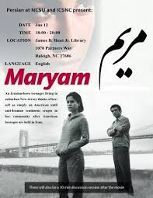
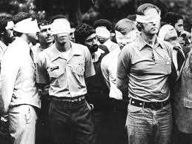
Maryum (movie) starring Mariam Parris
1979 Iranian Hostage Crisis

Slide 5
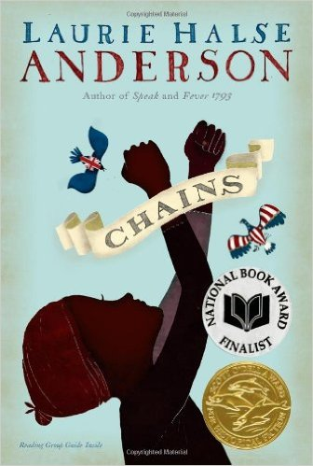
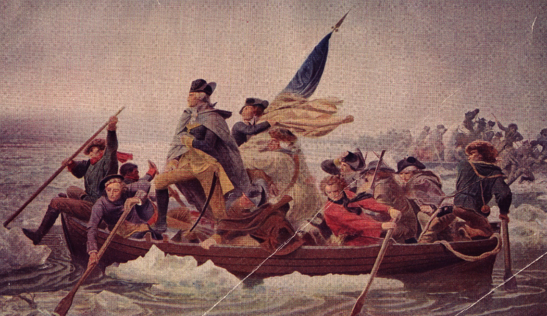
Chains by Laurie Halse Anderson
Isabel, the novel’s 13 year old protagonist, is enslaved and wants freedom for herself and her sister Ruth. Her goal is complicated by new malicious slave owners, and the explosive tensions of the 1775-83 Revolutionary war.

Slide 6
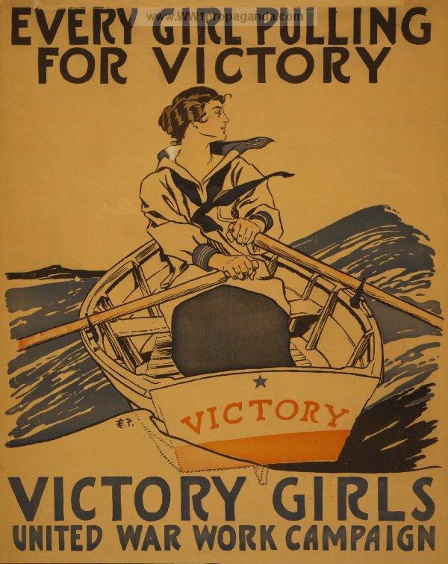
“War Girls” (poem) by Jessie Pope
There's the girl who clips your ticket for the train,
And the girl who speeds the lift from floor to floor,
There's the girl who does a milk-round in the rain,
Strong, sensible, and fit,
They're out to show their grit,
And tackle jobs with energy and knack.
No longer caged and penned up,
They're going to keep their end up
Till the khaki soldier boys come marching back.
Stanza One from “War Girls”

Slide 7
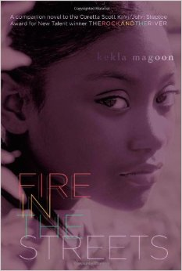
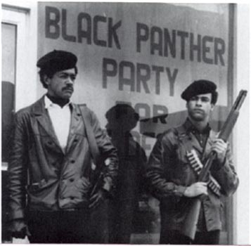
Fire in the Streets by Kekla Magoon
Themes:
Justice
Loyalty
Femininity
Independence
Ageism
1960s Black Panther Movement during the Civil RIghts era

Slide 8
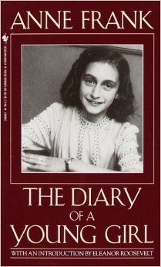
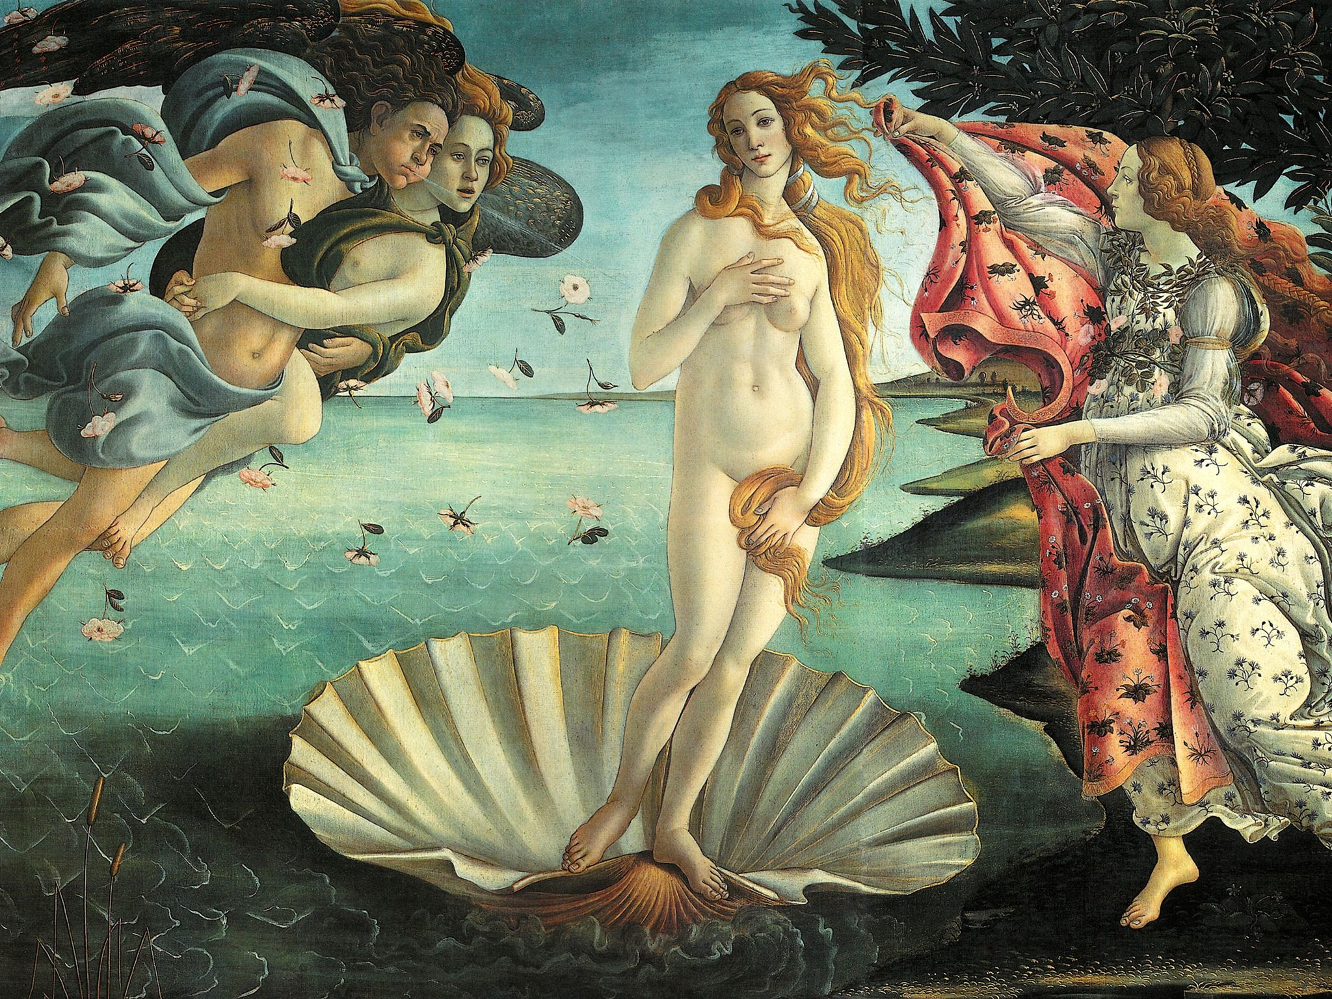
The Diary of a Young Girl by Anne Frank
“I go into ecstasies every time I see the naked figure of a woman, such as Venus, for example. It strikes me as so wonderful and exquisite that I have difficulty in stopping the tears rolling down my cheeks.” - Anne Frank, January 1944

Slide 9
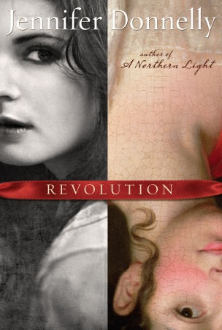
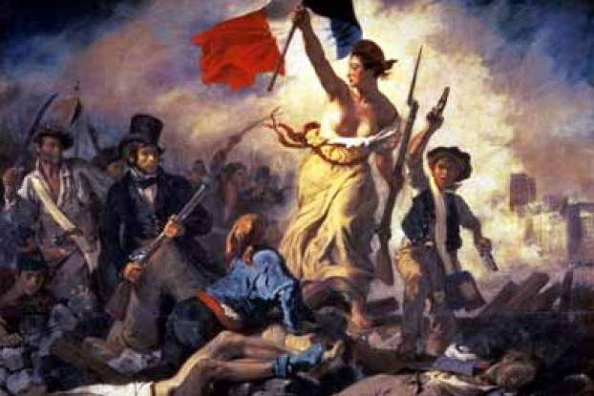
Revolution by Jennifer Donnelly
1789-1799 French Revolution

Slide 10
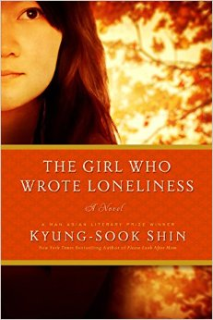
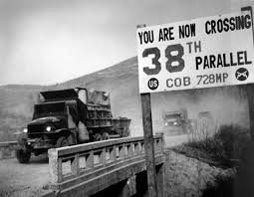
The Girl Who Wrote Loneliness by Shin Kyung-Sook
During this time, South Korea had
An oppressive dictator
Low employment rates
Dangerous working conditions
Blatant sexism
& met political dissent w/ death
1970s post war Korea

Slide 11
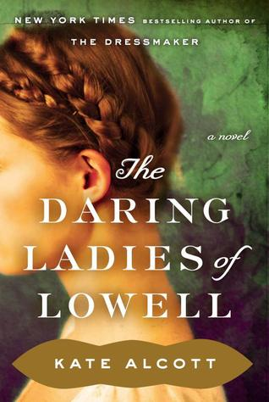
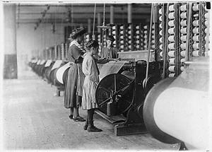
The Daring Ladies of the Lowell by Kate Alcott
Questions that give this book suspense:
Will Alice Barrow, the story’s protagonist, find justice, love, or both?
Can there be justice for the oppressed?
Who killed Lovey Cornell? Why?
1834, Lowell Mills Girls during the Industrial Revolution

Slide 12
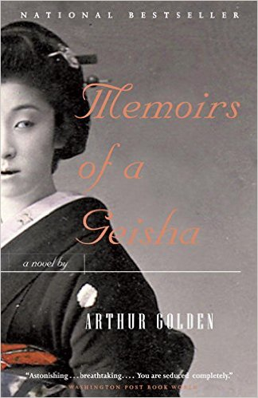
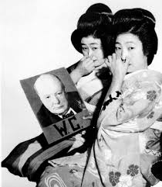
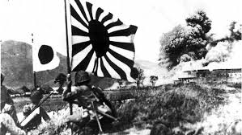
Memoirs of a Geisha by Arthur Golden
World War II: The Japanese perspective. Geisha life was threatened during WW2

