Slide 1
Real Life Experiences in Literature
Mariah Scott
English 112B
Unit of Study

Slide 2

Central text:
The Pigman by Paul Zindel
The Pigman was first published in 1968 and follows teenagers John and Lorraine as they navigate their feelings of guilt and loss towards the death of a man they befriended through a prank call named Mr. Pignati (Goodreads).

Slide 3
Rationale:
The Pigman deals with topics of grief, blame, family life/ home life and focuses on the concept of coming to terms with actions or mistakes that have been made.
The novel portrays the importance of empathy in decisions, and overall focusing on having empathy for those around us.
Reading inspires empathy– through reading stories like The Pigman, teens can observe how others around them should be treated with kindness.

Slide 4


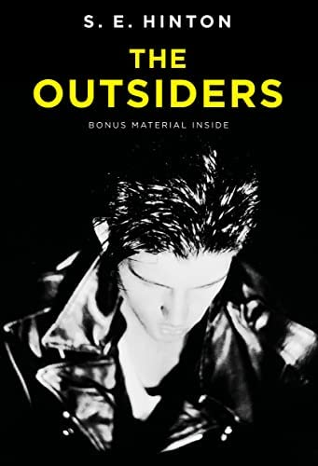
Companion Texts:
We Were Here: Matt De La Peña
We Were Liars: E. Lockhart
The Outsiders: S.E Hinton
Similar to The Pigman these texts all deal with the concept of grappling with feelings of guilt, loss, and grief and coming to terms with actions that have been made.

Slide 5
Introducing the unit and engaging students with the text :
Open the unit with a video on decision making titled, “Teenagers and Responsible Decision Making” https://www.youtube.com/watch?v=ahhKyEw9xUc
After the video I would ask my students to reflect on their thoughts of the video and write on what empathy means to them.
I would then begin reading The Pigman as a whole class

Slide 6
Through the unit:
Activities and resources
Daily journal or log on points students believe are important from the text.
Analyzing “The Road Not Taken,” by Robert Frost and applying this to The Pigman– how does the poem apply to decision making within The Pigman?
Group work: Students will work in groups of 3 to analyze climax points of the text and discuss the overall events that lead up to these points

Slide 7
Beyond the unit: conclusion
When we are finished reading the novel as a class, I will ask students to complete a 3–5-page essay that displays critical thinking towards the text. Students will either work from an essay prompt provided or are able to write on a topic within the novel of their choosing.
Essay prompt:
What is the importance of decision making within The Pigman? How do the decisions that John and Lorraine make ultimately shape the outcome of the story?

Slide 8
Thank you!

Slide 9
Works Cited:
De La Peña, Matt. We Were Here. New York, Penguin Random House, 2009.
Frost, Robert. “The Road Not Taken.” 1916. Poetry Foundation, https://www.poetryfoundation.org/poems/44272/the-road-not-taken. Accessed December 3, 2022.
Hinton, S.E. The Outsiders. 1967. New York, Viking Books for Young Readers, 2006.
Lockhart, E. We Were Liars. New York, Delacorte Press, 2014.
“Teenagers and Responsible Decision Making.” Youtube, uploaded by Decision Education Foundation, December 2021, https://www.youtube.com/watch?v=ahhKyEw9xUc.
“The Outsiders.” Goodreads. https://www.goodreads.com/book/show/231804.The_Outsiders. Accessed December 1, 2022.
“The Pigman.” Goodreads, https://www.goodreads.com/book/show/128092.The_Pigman.
“We Were Liars.” Goodreads, https://www.goodreads.com/book/show/16143347-we-were-liars. Date accessed December 1, 2022.
Zindel, Paul. The Pigman. 1968. New York, HarperTeen, 2005.

