Slide 1
Southern Gothic Literature
by Sara Talbot

Slide 2
Common themes of Southern Gothic Literature include eccentric, disturbing, or deeply flawed characters who are usually in decayed or derelict settings, with a fixation on the “grotesque” which usually stems from poverty, alienation, crime, violence and racism.

Slide 3
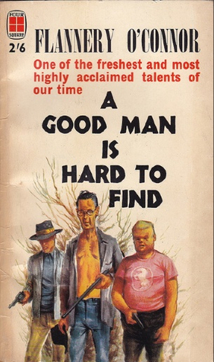
Flannery O’Connor
This short story is about a family of six who are driving from Georgia to Florida and on the way they get intercepted by an escaped convict and his posse.
“A Good Man is Hard to Find” is a great short story, however the language is racist and very reminiscent of the time it was written.
Allow students to ask questions surrounding O’Connor and her backstory as well as her many works.

Slide 4
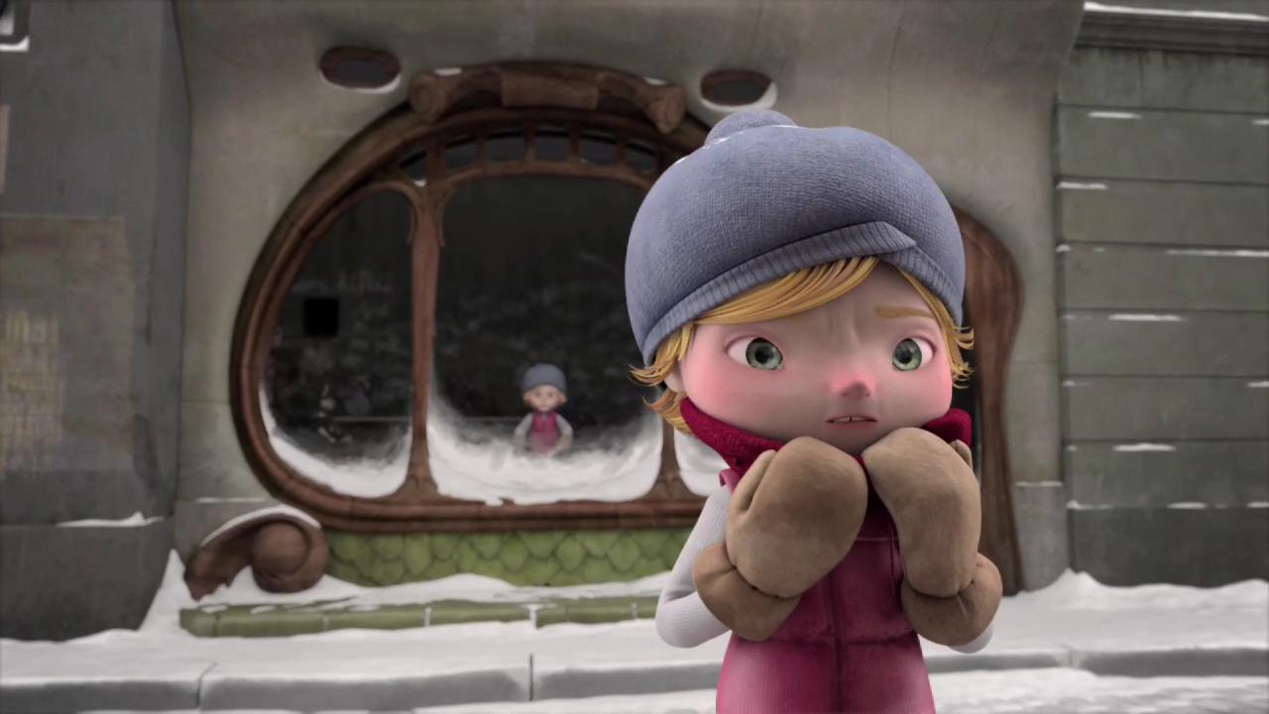
To Start the Unit
Do a powerpoint presentation on Flannery O’Connor and her history.
Watch the short film “Alma” and have the students give their thoughts on
https://youtu.be/Aw0uORumRts
Do a creative writing assignment on “Alma”

Slide 5
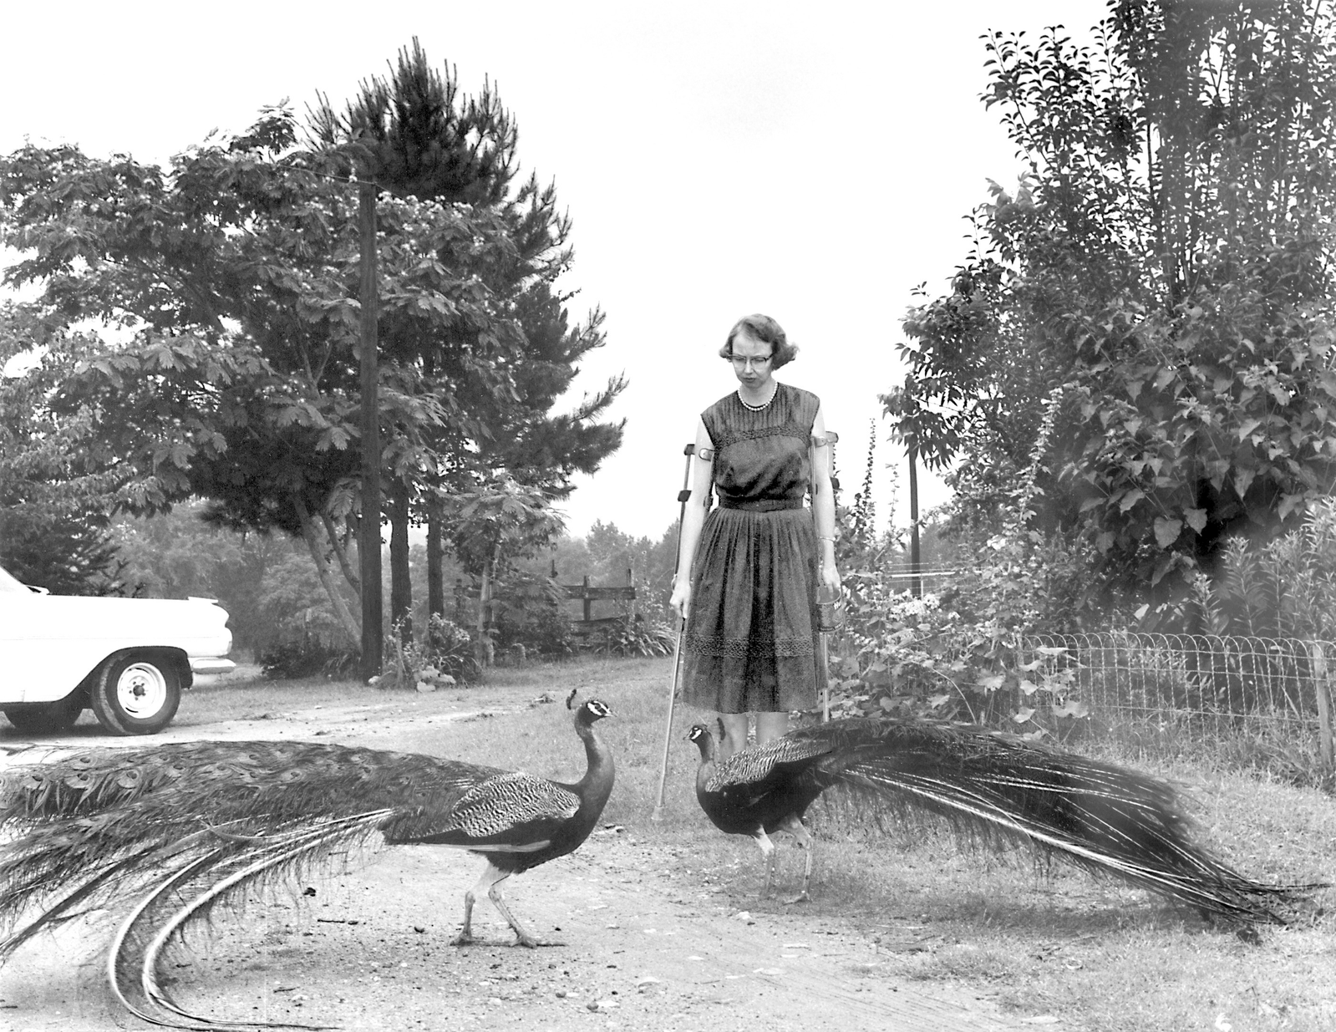
“A Good Man is Hard to Find”
After having the students read the short story on their own, I would ask them to make a journal entry immediately after reading it encompassing their feelings about the work.
Group share surrounding the initial reactions that each student had.

Slide 6
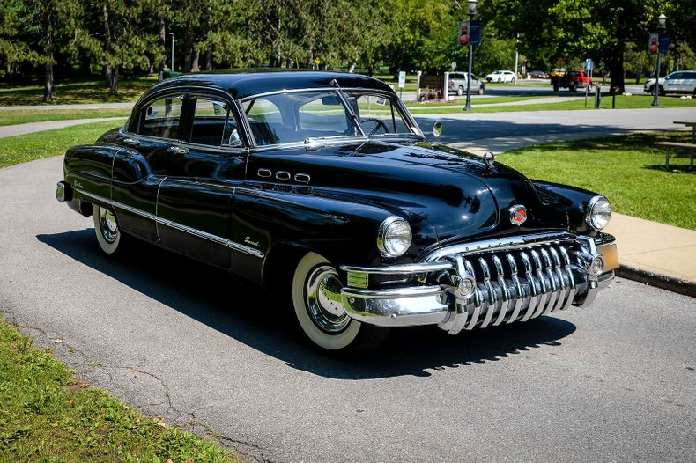
First Activity
Have the students in groups plan a “road trip” that the family would have been on in “A Good Man is Hard to Find”
Look online for a map from Atlanta to Florida from the 1950’s
Have the students go through photographs from famous Southern Gothic photographers and put together a slideshow to show the class what their trip would have looked like.

Slide 7
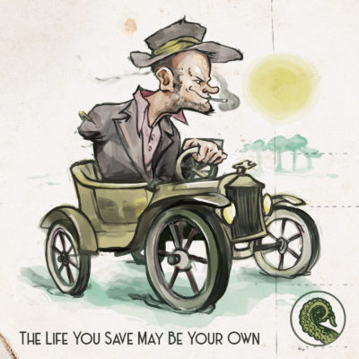
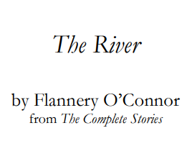
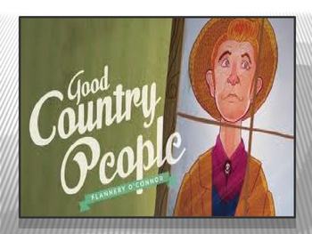
Second Activity
Take three other Flannery O’Connor short stories and assign each student a new story.
Have the students after they have read the story come together as a group to explain what they have read
Have the students figure out how each story relates to the other and how they all in turn either emulate the Southern Gothic stereotype or the idea of the “grotesque.”

Slide 8
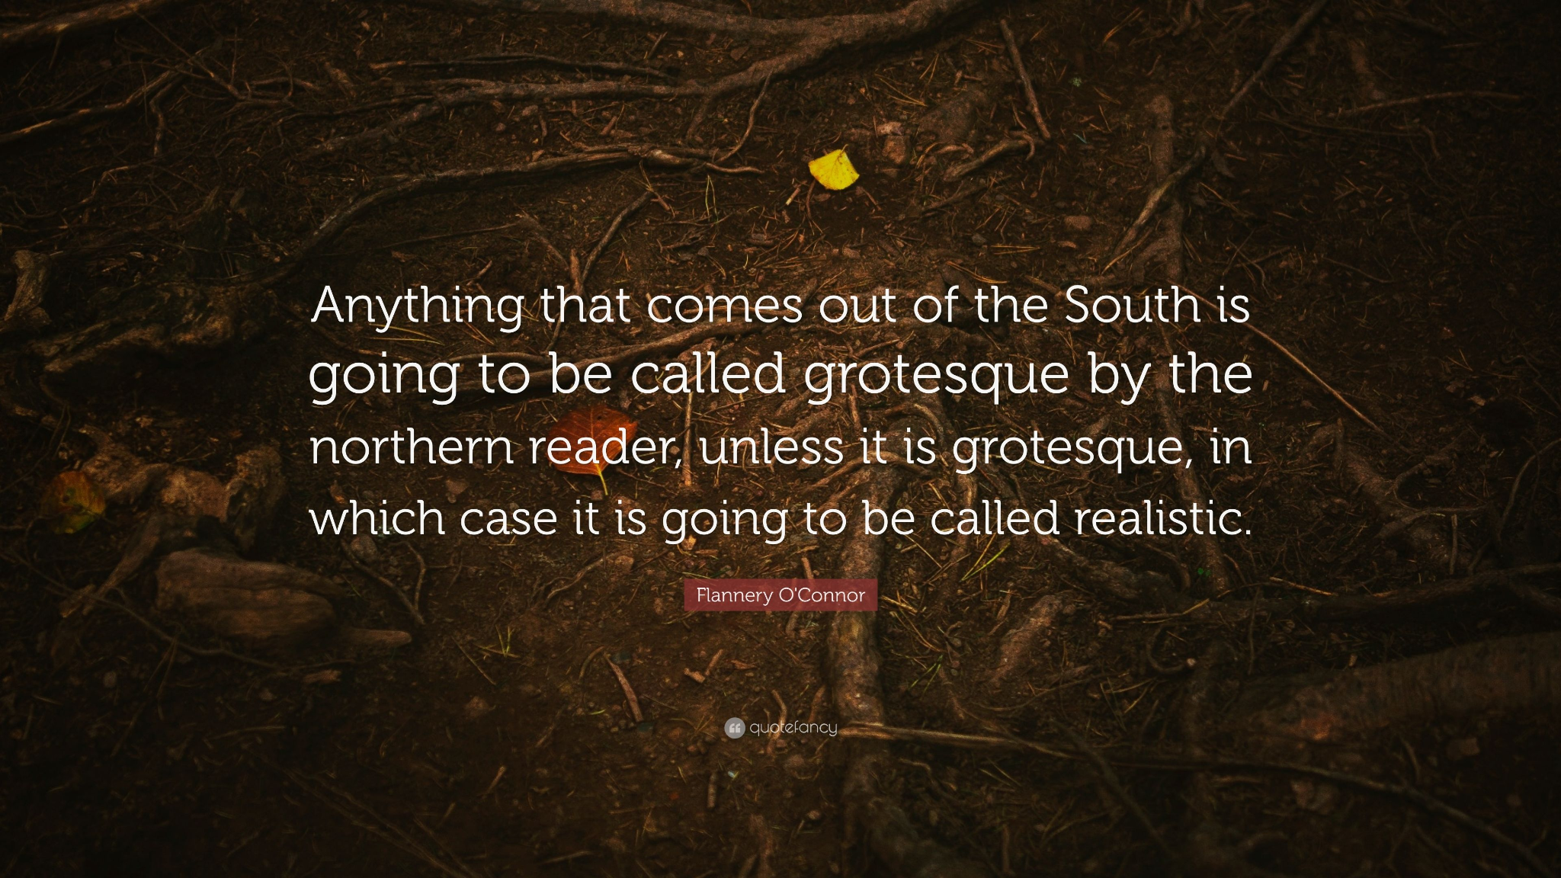
Third Activity
Grotesque versus Humor
Have the students analyze the quote in relation to the story.
Think about and go over these questions:
How would you define the words "gothic" and "grotesque"?
What does O'Connor mean by "grotesque"?
What elements of "A Good Man is Hard to Find" would you describe as "grotesque"?
What elements of "A Good Man is Hard to Find" would you describe as humorous?
What are the effects of O'Connor's being both humorous and grotesque in "A Good Man is Hard to Find"?

Slide 9
All of this Culminates into an Essay
Second Option:
Identify who is the real “Misfit” in the story and use evidence from the primary source material to support the claim.
Third Option:
Find the humor in the grotesque. Analyze O’Connor’s use of the grotesque and humor in the text.
First Option:
Using the three different stories by O’Connor, write a paper examining the significance of the Southern setting in the stories. Use the primary source material explored in this lesson to detail O'Connor's portrayal of the South.

Slide 10
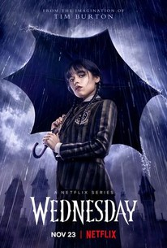
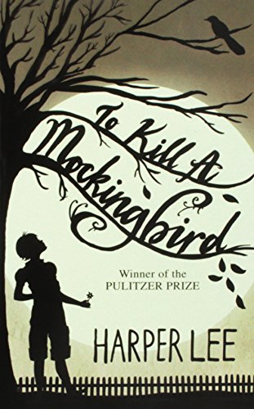

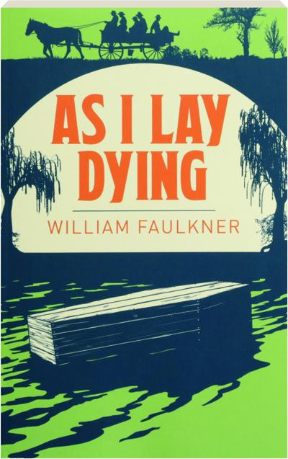
Related Media and Literature

Slide 11
The End?

