Slide 1
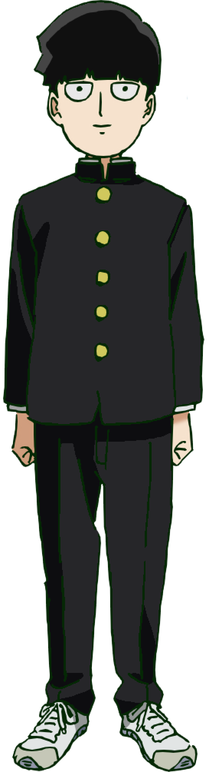
“Your Life Is Your Own!”: A Unit Of Study of Purpose thru Graphic Novels
Justin Nguyen, ENGL 112B

Slide 2
Rationale
Graphic novels are often shunned for having illustrations over traditional novels as legitimate literature, especially in classroom settings
At the same time, many students grapple with their decisions for the future, their purpose in life beyond high school
This unit will address both aspects of these conflicts; exclusively introducing a selection of graphic novels throughout this unit, with each graphic novel exploring self-autonomy, consideration for one’s future, and even dying/effects of dying

Slide 3
Basic Format For Unit Of Study
-This unit will take roughly 8-9 weeks; with 3 graphic novels discussed in class+ one ongoing manga series
-each graphic novel will cover a different aspect of the main theme of my unit of study: “finding one’s purpose”
-spend three weeks on each of the in-class novels, manga series will be read at home/on student’s time over the entire unit.

Slide 4
Content Per 3-Week Period
-There will be one major project due every three weeks per graphic novel, related to the themes present for each novel(ie, Venn diagram for The Eternal Smile)
-content mostly discussion-based around various prompts, supplementary articles (ie, hospice reports for All Star Superman)
-

Slide 5
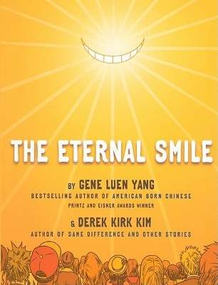
Companion Texts: “The Eternal Smile” by Gene L. Yang
-This graphic novel offers three short
stories, each story with themes of escapism
-Per weeks, students will engage in discussion relating to each of the short stories, one story per week

Slide 6
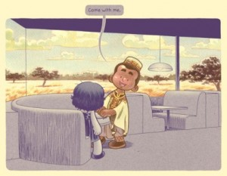
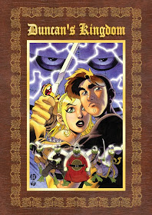
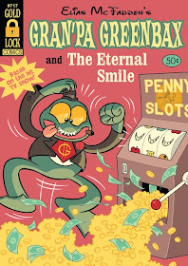
Eternal Smile(cont)
-Possible prompts include: “What is humanity’s primary goal?” “What is your most important thing?”
-Supplementary articles will provide context for each setting (ex:
an article regarding Nigerian prince scams for “Urgent Request”)
-final project: Venn Diagram comp/contrasting each short stories take on escapism

Slide 7
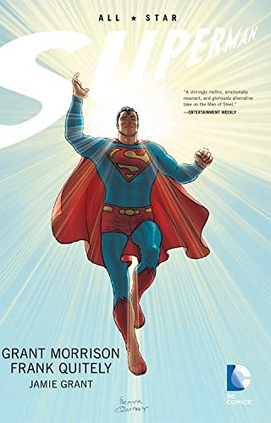
All Star Superman by Grant Morrison
-Superman is caught in a freak accident that leaves
him left with a limited amount of time to live
-contains themes of legacy, impact, dying
-possible prompts include:
“What matters when you die?”
“What is a good way to die?”

Slide 8
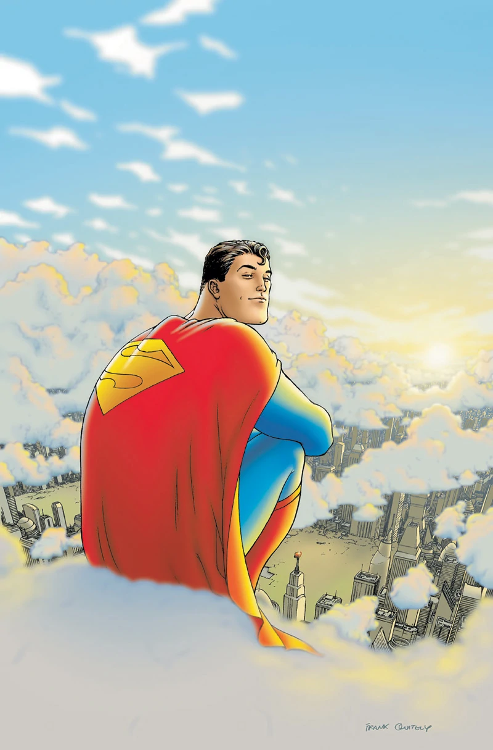
Superman (cont)
-supplementary articles may include: a Nov 2021 issue of Scrubs magazine, a nursing blog post regarding hospice workers experience with dying patients
-additional activity: college prep “where will you go?” activity, further tying into the theme of lasting impact on the future
-final project: an essay about each student’s “bucket list”, detailing things they want to do/people they want to grow closer to before they die

Slide 9
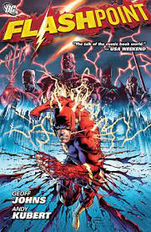
“Flashpoint” by Geoff Johns
-a tale where The Flash’s timeline is altered due to his deceased mother being brought back to life, creating a butterfly effect
-concludes with Barry reversing his mother’s revival for the sake of the world
-conclusion of Flashpoint contains themes of sacrifice, responsibility

Slide 10
Flashpoint (cont)
-possible discussion prompts include: “what did it take for you get in this situation now?” “What would you sacrifice for your goals/future?”
-additional articles/activities may include examining the Hero’s journey, contextualizing Flash”s sacrifice as the Transformative/Atonement stage
-relevant in that many students will have to/are already questioning their Transformative process
-final: Web diagram, with the center being what would happen if the student disappeared, and each connecting web bubble detailing its effects

Slide 11
Main Text: Mob Psycho 100 by “One”
-Mob is a simple boy with incredible psychic powers struggling to find simple happiness in a world that keeps unrelenting pressure on using his psychic powers “correctly”
-in additional to every theme coveted so far, Mob’s main message is one of self-determinism; it’s main theme in the anime adaptation is “Your Life is Your Own!”
-students will read the entirety of the manga series over the course of this unit

Slide 12
Final Assignment: Mob Diary
-students will log their thoughts on their purpose as the semester progresses, with the goal being to see their change in perspective between the first day of class and after they’ve read the entirety of Mob Psycho 100.
-they essentially log their own hero’s journey through my unit of study, showing the gradual realization of their purpose through their work in this class and while reading Mob Psycho 100.

Slide 13
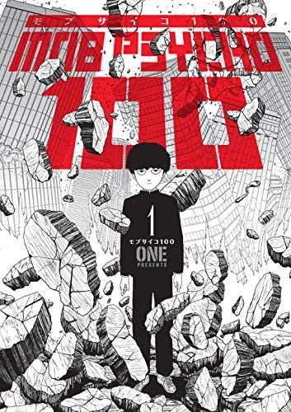
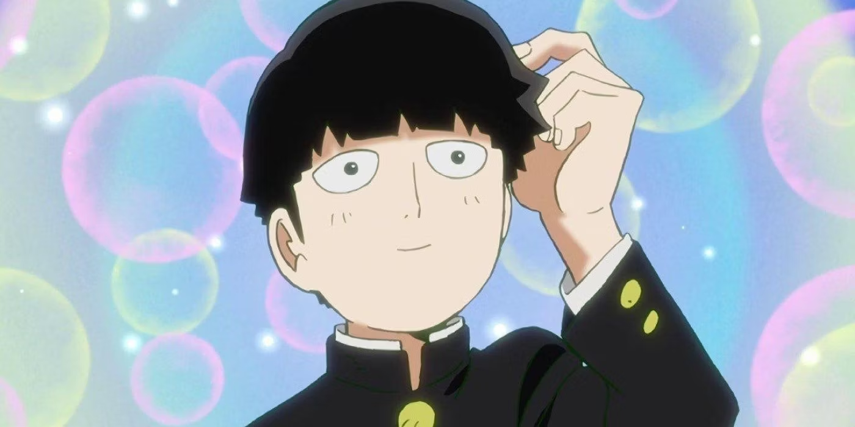
Thanks For Listening! Your Life Is Your Own!!!

