Slide 1
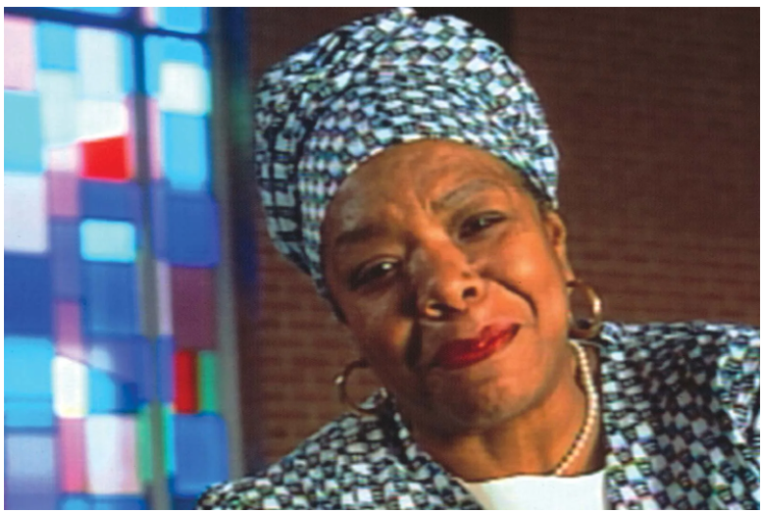
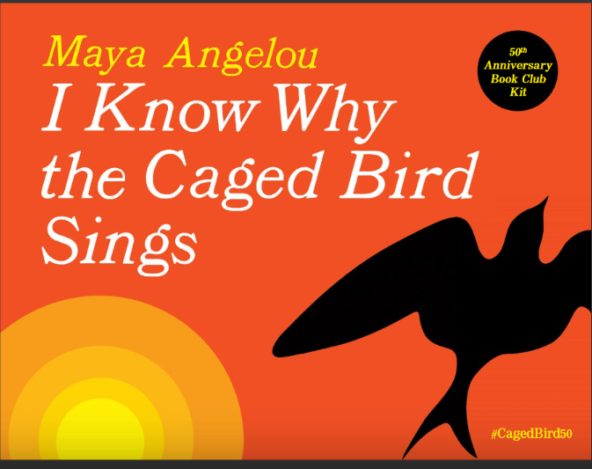
Facing Violence and Abuse in Maya Angelou’s I Know Why the Caged Bird Sings
By Fatima Farheen
(Unit of Study)

Slide 2
Rationale
1 in 4 girls and 1 in 13 boys in the U.S. face childhood sexual abuse, and 91% of perpetrators are
someone who they love and trust (Center for Disease Control and Prevention, 2022). Consequently, these children suffer from anxiety and depression, and other behavioral issues. In the novel, Maya Angelou goes into silence for months and do not reveal her pain to anyone.
The rationale behind reading this text is to bring awareness in students in critical situations and learn skills to combat situations. So, this book can serve a better example of how to deal with situations: sexual abuse, peer pressure, discriminaiton, racism, cyberbullying, alcohol and drugs, body image,rejection, teen pregnancy.

Slide 3
Why did I chose this topic?
In the Speak, we saw how Mr. Freeman was constantly empowering and encouraging his students to find comfort in their art. On the other hand, Mr. Neck was using his authority and breaking his bond with his students. Every time, he misunderstood Melinda accusing her. So, I want to be like Mr. Freeman who can help his students in finding ways to express themselves and excel in their live. Most importantly, by bringing the issue and punishing the perpetrator so that no one could dare to abuse any child or adolescnet.
This is why, I chose this book to make my students understand that abuse can happen in any age by any one. Firstly, I make them realize that they are not alone and there are people to help. Also, ways to fight their fears.

Slide 4
Into the text
I will start my lesson through google slide and showing the book image
  Questions about the image and the title
  Giving them an explanation about the book (author’s information, why and how she wrote the book, specifying she is the victim and the main character of the story)
  I will explain or ask question why do you think this book could be important to YA
  How do they understand the issue and connect it to real world
  Also, share a story of Jacqueline Woodson (her real-life experience in the class)
  Lastly, would this be a good canonical piece to include in YA sources

Slide 5
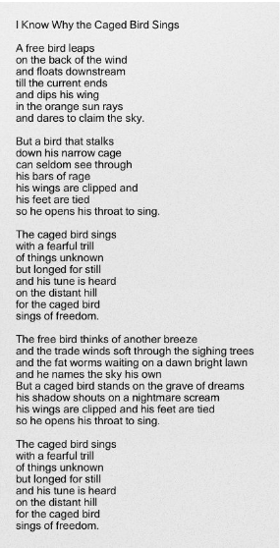
Into the text
Ask students to read stanza by stanza and relate to the title and the message in the book

Slide 6
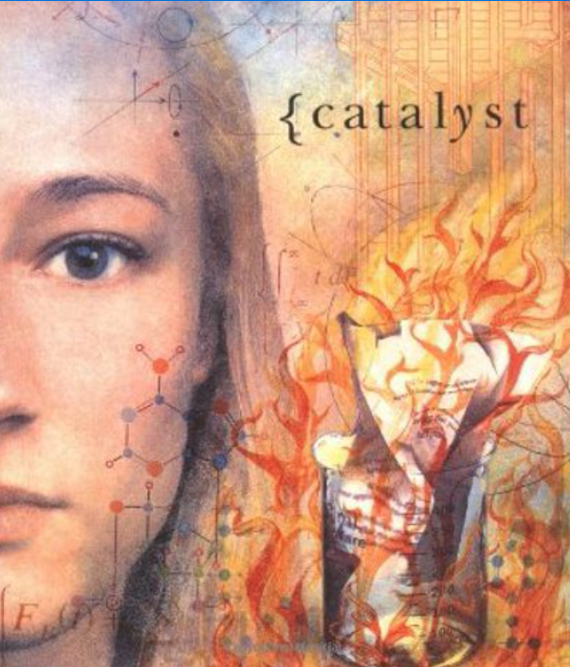



Companion Novels
Catalyst by
Laurie Anderson
Speak by
Laurie Anderson
She’s Come Undone by Wally Lamb
Staying Fat for Sarah Byrnes by Chris Crutcher

Slide 7


Whale Talk by Chris Crutcher
A Question of Mercy by Elizabeth Cox

Slide 8
Through the Text
Students will read with the teacher as a whole class (use audio as well)
Divide students in a group of two or three
Ask them to find quotes from the text and discuss how it is related to the topic (facing violence and abuse)
Also, ask students to pick a companion novel and ask them to find relevant situation about consequences from the topic (every group will pick a different novel)
Additionally, show them the movie and ask them how the movie is different from the book

Slide 9
Beyond the Text
Students will discuss:
What is literary canon?
Why is it important?
Do you think this novel or other above novels should be included in the YA curriculum sources? If yes/no why?
What they think about the topic and other topics from today’s technological world?
What similarities they see between the characters in different novels? (as every group will read the different novel, they will share their information and bring more information to the topic)

Slide 10
Beyond the Text- Writing and Presentation (Activities)
Students will either work in group or can individually work on their presentation connecting the novel with other novel/movie
students find quotes from the novel and connect it to the topic
students will pair in groups and relate the text to text and then to the topic and then to the world
they have to give the presentation how the novel can help YA in combating their fears and violence
Comparing movie and the novel and relating it to the text
All this can be done into a presentation format and the writing prompt

Slide 11
Work Cited
Centers for Disease Control and Prevention. (2022, April 6). Fast facts: Preventing child sexual abuse |violence prevention injury Center CDC. Centers for Disease Control and Prevention. Retrieved November 24, 2022, from https://www.cdc.gov/violenceprevention/childsexualabuse/fastfact.html
Warner, M. L. (2006). Adolescents in the search for meaning: Tapping the powerful resource of story. Scarecrow Press.

