Slide 1
The Hero’s Journey and The Odyssey
Unit of Study
Tiffany Vasquez

Slide 2
What makes a story fun?

Slide 3
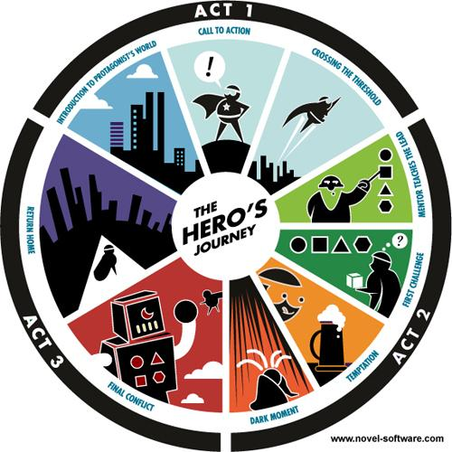
The Hero’s Journey
Adventure
Excitement
Multiple influences
What makes a hero?
http://www.yeahwrite.org/wp-content/uploads/Heros-journey_2.jpg

Slide 4
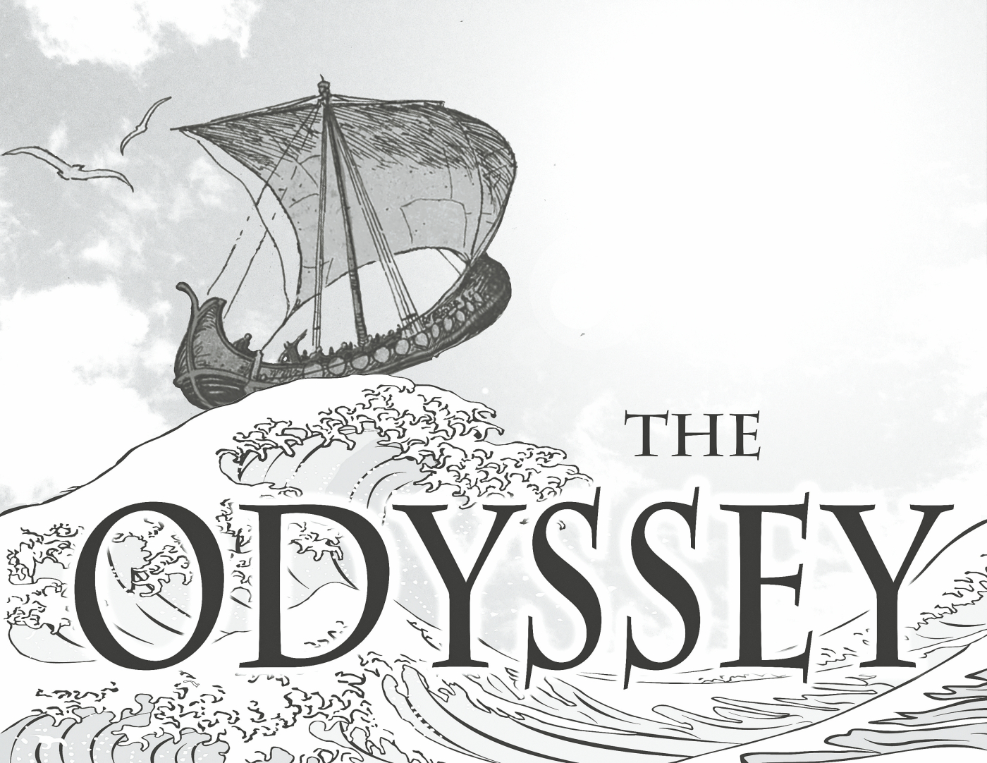
The Odyssey Unit
Definition of terms/elements
  The Hero’s Journey
  Protagonist/Antagonist
  Conflict (internal/external)
  Allusion
  Etc.
The Iliad
https://astrochara.files.wordpress.com/2016/07/a7f1c41c-9bb4-4581-b969-2d91e8f5834f1.jpg?w=1400

Slide 5
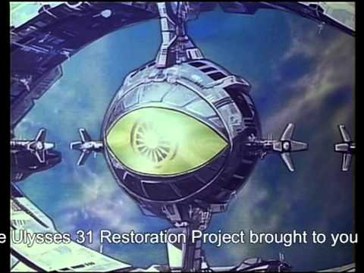
https://www.youtube.com/watch?v=Ev1aBt-_Zs4

Slide 6
The Odyssey Unit
Reading by “sections”
Questions for each “section”
  Comprehensive for reading checks
    “How does Odysseus trick Polyphemus to escape the cave?”
  Reflective for student’s opinions
    “What are characteristics of heroes? Does Odysseus fit these characteristics?”
  Both class-wide and small group discussions

Slide 7
The Odyssey Unit - Major Assignments
Alternative Narrative
  1-2 page creative narrative from the perspective of character other than Odysseus
  Play with the concept of protagonist and narrator
The Odyssey Teaching Method
  Small groups of 2-3 students
  Pick one of the events from The Odyssey and develop a teaching method for 6th graders
  Inclusive to multiple learning preferences
  Essay on rationale behind their teaching method
  Final presentation

Slide 8




YA Connections
The Hobbit - J.R.R Tolkien
A Wrinkle in Time - Madeleine L’Engle
Ready Player One - Ernest Cline
The Hunger Games - Suzanne Collins
American Born Chinese - Gene Luen Yang
The Alchemist - Paulo Coelho
Life of Pi - Yann Martel
https://images-na.ssl-images-amazon.com/images/I/51uLvJlKpNL._SX321_BO1,204,203,200_.jpg
https://images-na.ssl-images-amazon.com/images/I/51NzrYog-7L._SX322_BO1,204,203,200_.jpg
https://images.gr-assets.com/books/1483412266l/865.jpg
https://images-na.ssl-images-amazon.com/images/I/81E9oNSK3bL.jpg

