Slide 1
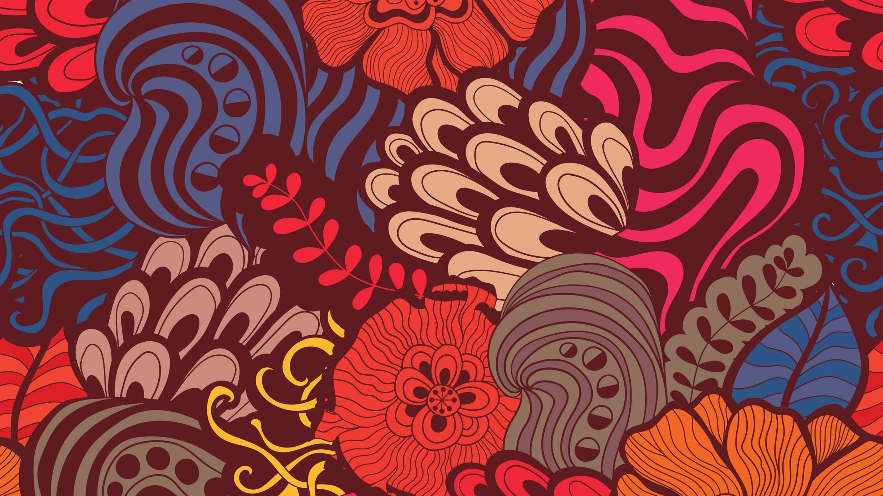
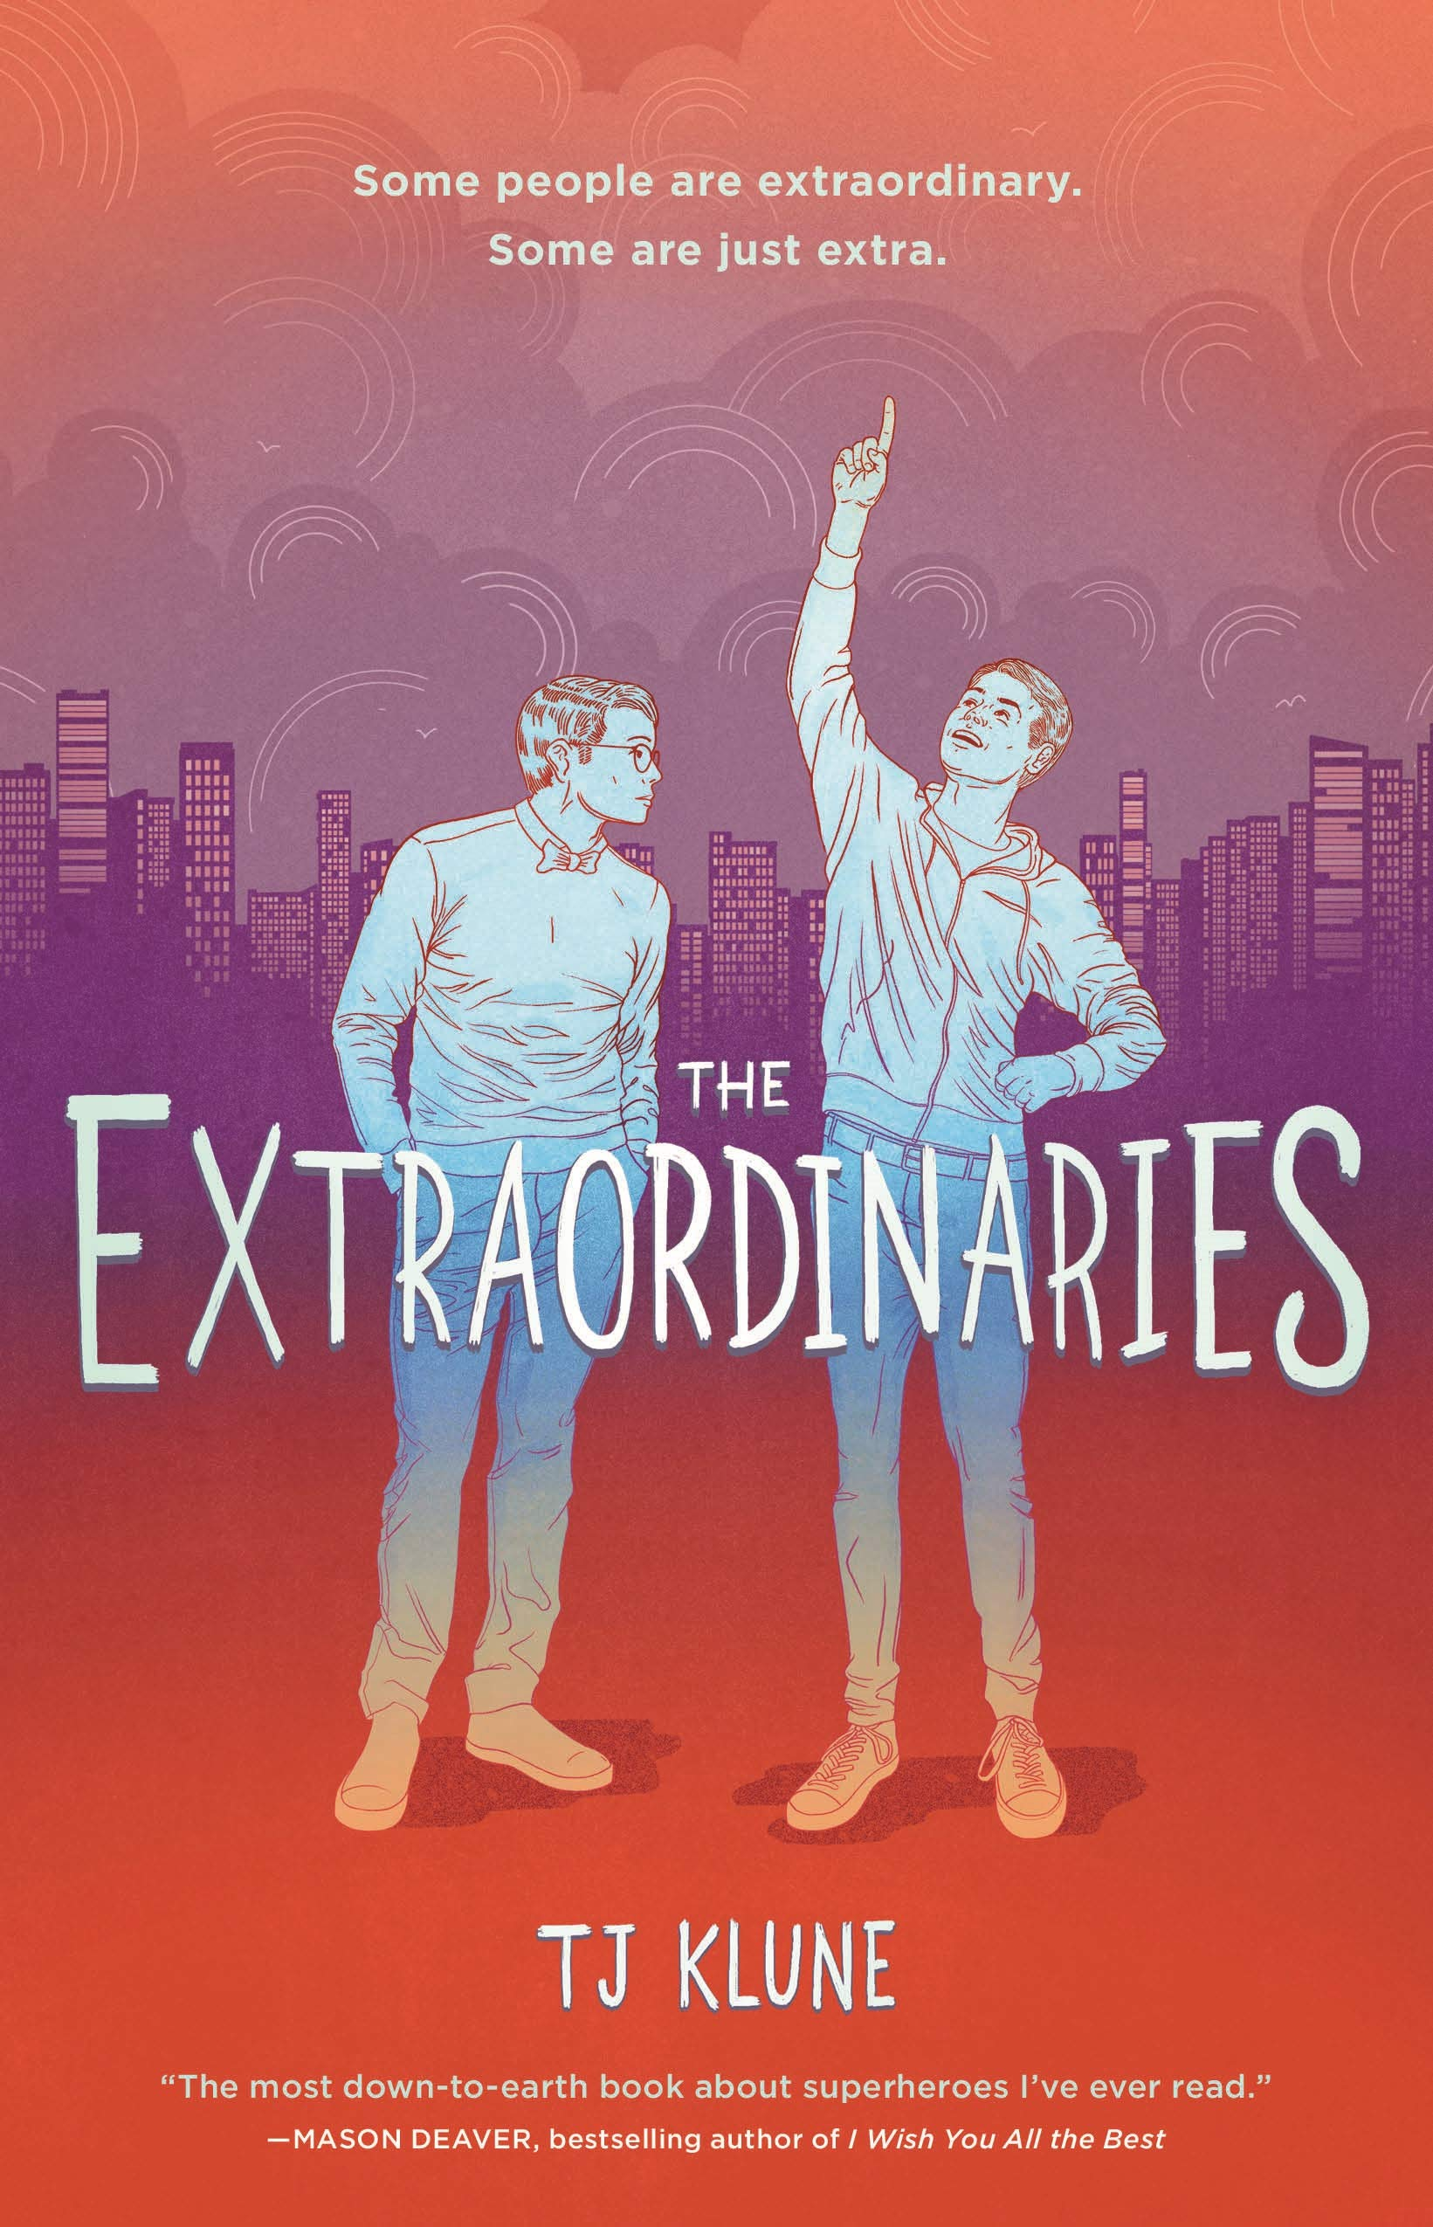
Book Talk
The Extraordinaries
By Lily Marshall
Novel by TJ Klune
Image from Amazon

Slide 2
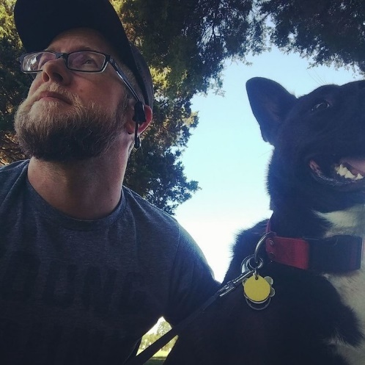
About the Author
Image from
Author’s Website
Name: TJ Klune
Website: http://www.tjklunebooks.com/
Informative Tidbits:
TJ Klune is currently the author of fourteen novels with more on the way.
Every book he has written thus far features a queer protagonist
He won the Lambda Literary Award for ‘Best Gay Romance’ in 2014 with his novel Into the River I Drown
He believes that, in his own words: “It's important—now more than ever—to have accurate, positive, queer representation in stories.”

Slide 3
Novel Summary
The Extraordinaries is a book about a gay teen with ADHD named Nick Bell who lives in a world where superheroes—known as Extraordinaries—are real. After the death of his mother, an event which separated his life into Before and After, Nick coped with the help of his ragtag group of friends consisting of the lesbian couple Gibby and Jazz, his best friend Seth, and the sexually frustrating existence that is Owen Burke.
The novel is a both hilarious and painful read, as Nick clumsily attempts to navigate his daily life with a brain that won’t sit still, a father who is trying his best, an Extraordinary named Shadow Star who he may or may not have an unhealthy obsession with, and most of all, with his insatiable desire to become extraordinary himself.

Slide 4
Context For Quote 1
Nick Bell, under the username Shadowstar744, is the proud author of a self-insert romantic fan-fic between the Extraordinary hero Shadow Star and the original male character Nate Belen.
Nick, in this scene, is reading through the comments on his latest update to the story, one of which is by a user named FireStoned who seems displeased about Shadow Star being portrayed as gay.

Slide 5
Quote 1
“Nick Bell stared at his phone as he shifted on his bed in his room. “Not gay,” he muttered to himself. “He has sequins on his costume.” He thought about deleting the comment, but others were already responding to it, coming after FireStoned with a vengeance, so he decided to leave it up. Whoever FireStoned was, they’d learn fast that one absolutely did not comment on a ShadowStar744 fic like that. After all, Nick was one of the most popular writers in the Extraordinaries fandom (even if he’d had to use the screen name of ShadowStar744 since Shadowstar1-743 were already taken, those bastards), and slash would always be more popular than the hetero nonsense FireStoned seemed to want. Straight people, Nick thought as he shook his head. He’d never understand them.
The other forty-two comments, though. They weren’t too shabby. Especially for a shorter chapter that ended on the thirty-second cliffhanger in a row. Thank god his fans understood. They were the only reason he’d continued writing what could be considered a quarter-of-a-million-word masturbatory ode to Shadow Star. Without them, the fic probably would have ended a long time ago, or worse, been one of those unfinished works that turned into a cautionary tale for new people in the fandom. He could deal with the occasional idiot like FireStoned.” (13)

Slide 6
Significance of Quote 1
This quote, which comes right at the very beginning of the book at the start of the first chapter, does a really good job, I feel, of establishing the protagonist’s mindset along with the setting. This book is very clearly targeted at a contemporary young adult audience who is well-versed in the internet and is at the very least aware of things like Tumblr and fan fiction.
Since I haven’t read much recent realistic fiction,
it was a strange, somewhat refreshing experience to be shoved into the perspective of a character who was doing something as 21st century and as gay as writing a gay fanfiction online
and I feel that the quote does a good job of quickly establishing Nick’s character as well as the tone of the novel.

Slide 7
Context For Quote 2
Ever since his mother’s death, Nick’s relationship with his father has been somewhat… strained at times
Prior to this scene, Nick has just made a critical error, as he is prone to do, and his relationship with his father is about to suffer because of it.
His father, it should be noted, is a good person and a well-written character; however, what follows is not one of his better moments

Slide 8
Quote 2
“Dad began to pace, shoulders stiff. ‘Because I asked you for this one thing. For this year to be different. For you to do everything you could to be the best possible person you could be. And all I’m seeing here is that it’s more of the same.’
‘I’m sorry I’m such a disappointment to you,’ Nick said bitterly, wiping his eyes.
‘Dammit, kid. First it was Owen, and I let it go. And then it’s this—this Shadow Star, and this weird obsession you have with him. I just don’t—why do you have to be this way? Why do you have to be the way you are?’
Nick knew the power of words. He knew that sometimes when they landed, they exploded with the force of a carelessly tossed grenade. Nick heard what his father said. He heard every word. They exploded at his feet and shredded his skin.
… [later] He was on the train, surrounded by people and staring blankly ahead when his phone buzzed. Nick thought about ignoring it. He pulled it out of his pocket. A text from his dad. He really thought about ignoring it. But maybe it was an apology. Maybe it was Dad saying he was sorry, that he didn’t mean it, that he was just fine with the way Nick was, that he didn’t need him to be anything more. He opened the message.
--- You forgot to take your pill this morning. Called the school. Nurse will have your dose. See her before class. ---
And that was it. Nick deleted the message before sliding the phone back in his pocket. The train car rocked gently beneath his feet.” (167-168)

Slide 9
Significance of Quote 2
Honestly, every single conversation between Nick and his father could be in here. Their relationship feels incredibly natural, tangible and overall well-realized. Their banter is entertaining to no end, and there are numerous emotional and heartwarming moments between them that made me legitimately smile while reading.
However, it is for that exact reason that I picked this quote, a quote that is neither funny nor heartwarming. This quote, and the events that follow from it (such as the next quote), really exemplifies the idea that a single word or phrase spoken in anger can seriously impact someone, especially someone with a brain like Nick’s which tends latch onto things and run with them until it reaches the logical extreme.
I wasn’t far into the book when I decided that one of the quotes absolutely had to be a conversation between Nick and his father and, having finished the book, I think that this conversation is the most significant of them.

Slide 10
Context For Quote 3
Nick is fighting with his dad, is feeling sexually confused in towards his best friend, has been off of his meds for three days, and has basically reached peak desperation in his attempt to become an Extraordinary.
He now stands, to the dismay of his friends Gibby and Jazz, on the precipice of a filthy, disgusting, sludge river wearing nothing but his boxers and a gaudy, oversized, rhinestone ring that he bought off eBay from a drag queen named Veronica B. Dazzled.
Will jumping into Nova City’s most disgusting river give him superpowers? Probably not, but Nick is at the end of his rope.

Slide 11
Quote 3 — Part 1
“’Now, wait a minute,’ Gibby said, taking a step forward. ‘Nick, you don’t need to do this, okay? It was a joke, man. Please don’t jump into the river. I’m pretty sure this is where they found that foot last year. Like, an entire human foot. Please don’t jump into dismembered foot water—and oh my god, why did you bring goggles?’
Nick fit the goggles over his eyes. ‘Protection. Everyone knows you should wear goggles when you go swimming.’
‘Nick, seriously,’ Gibby said, sounding alarmed. ‘Let’s figure out something else, okay? Or, hey! Maybe we should go find a TV somewhere to see if Pyro Storm and Shadow Star are still fighting or whatever. Wouldn’t that be cool? Maybe they’ve hit each other so hard, their costumes are torn and you can see skin!’
That was almost enough to derail him. ‘Foul temptress,’ he hissed at her. ‘I know what you’re trying to do, but it won’t work! I’ve thought this through.’
‘See, that’s the thing. I don’t know if you have. This is dumb, Nick. You know it is.’

Slide 12
Quote 3 — Part 2
The funny thing was, he did know that. Everything about this was stupid. But he couldn’t find a way to tell them how desperate he was, that he was out of ideas and that he had nothing left. He couldn’t tell them about his father’s words ringing in his ears over and over again:
Why do you have to be the way you are?
Pity. That was what he’d get from them. Pity. He didn’t want it. He just wanted to be different…
Gibby tried one last time. ‘Nicky, no!’
‘Nicky, yes!’ he crowed, and took off toward the edge of the pier. The wood creaked underneath his feet, and the rancid air whipped by his face. He clutched his hands into fists, feeling the ring that had cost thirty-seven dollars plus shipping sent to him by a drag queen from Milwaukee named Veronica B. Dazzled. And, as he reached the end of the pier and jumped as far as he could into the Westfield River, Nicholas Bell just knew it was going to work.” (215-217)
First line of Chapter 12: “It didn’t work.” (218)

Slide 13
Significance of Quote 3
I wanted to include this quote because I think that it best, out of any in the book, portrays the extent of this book’s absurdity and the untamable beast that is Nick’s brain. This scene is, I think, Nick’s most ridiculous moment.
However, while it may seem absurd to the point of being stupid to someone who is viewing it in a vacuum, Nick’s leap into the Westfield River comes at the end of a buildup of confusing and painful emotions, on top of it being his third day after stopping his medication cold turkey.
Moreover, as one may expect, this ludicrous free-wheeling high is followed by an incredible low. I think that this entire sequence of events is akin to a way in which Nick described his brain early on, which was something to the effect of: My brain runs and runs and runs and runs and runs; faster and faster and faster and faster until it inevitably crashes. This leap is the moment just before the crash.

Slide 14
Why Read This Novel?
As Literature
As Entertainment
While silly at times, I legitimately believe that this novel is an important one. I does a really good job at portraying the struggles of being a teenager, the struggles of being a gay teenager, the struggles of coping with the death of a parent, and the struggles of self-discovery and self-purpose.
I can’t think of another book that I read within the last decade that made me laugh as much a this one did. That said, it will take you through the full course of human emotions. There are cringey moments, hilarious moments, sickeningly sweet moments, and soul-crushingly brutal moments.

Slide 15
But all-in-all, it’s just a good read—one that I thoroughly enjoyed.

Slide 16
Thank You

